Slide 1
2025 Q1
Quarterly Market Review
Presented By: Mario Nardone, CFA

Slide 2
Quarterly Market Review
Positive Signals
Reasons for Concern
Global diversification boosted returns for U.S. investors in Q1
Germany is dramatically increasing defense spending while the UK is spending on housing and infrastructure
Recent macroeconomic data suggests the labor market remains solid
Inflation declined to 2.8% in the last reading from February 2025
Uncertainty as it relates to tariffs and impact of global trade wars
US consumer sentiment and confidence have declined
Growing skepticism around the timing and feasibility of future Fed rate reductions
U.S. stock markets are off to a sluggish start in Q1, heavily impacted by the Mag 7
Notes:
As always, we like to take a balanced approach to looking at the global economy and markets, not reacting too positively or negatively to any particular news item. Because it’s important to have a broad perspective and maybe even a sense of cautious optimism with what the future might hold.
To that effect, international diversification paid off tremendously for stock investors this quarter with examples of pro-growth measures being taken in the U.K. and Germany. In the U.S., while there’s been plenty of uncertainty afoot (more on that in just a moment I promise), recent data and commentary from the Federal Reserve suggests we’re still in good shape from a labor market and economic growth perspective while inflation remains moderate.
Some sources for uncertainty relate to recent tariff policy from the White House in Q1 which has played a factor in declining consumer sentiment and confidence as well as muddying the waters for the Fed on future rate cut decisions. And incase you hadn’t noticed, the tried and true Magnificent 7 stocks have had a tough start to the year, weighing on U.S. stock market performance overall.
Let’s take a look at Q1 by the numbers to put some quantitative context to what we see here.

Slide 3
Q1 By the Numbers
4.25% - 4.50% remains the Federal Reserve’s policy range as inflation has held steady and the labor market has shown no signs of imminent collapse. Combined with potential inflation, the Fed seems to be in a wait and see mode, with no further reductions imminent.
65.2 is the latest reading for the consumer confidence expectations index, which measures U.S. consumer expectations for business, income and jobs. This is the lowest level in 12 years and well below the threshold of 80, a recessionary indicator.
10.9% is the amount that international large cap stocks (MSCI EAFE) outperformed US large cap stocks (R1000) YTD, highlighting a current benefit of being globally diversified.
-0.3% is the YTD return of a portfolio comprised of 60% MSCI ACWI and 40% Bloomberg Global Aggregate (hedged USD). In other words, despite the headlines for US stocks, a globally balanced portfolio comprised of both stocks and bonds is relatively flat YTD.
Notes:
As a refresher for those who don’t follow the Federal Resrve as closely as we do, they ended the last few months of 2024 with three quarter-percentage point rate cuts but have left rates untouched since then at their current policy range of 4.25% to 4.5%. With labor markets remaining resilient and still more progress to be made on the inflation front, the Fed is in wait-and-see mode for now.
65.2 is in reference to the latest reading for the consumer confidence expectations index. Essentially, what this means is that U.S. consumers’ expectations for future income and jobs prospects are at their lowest level in 12 years. Some view this as an early recession indicator.
As mentioned on the prior slide, international stocks largely outpaced U.S. stocks in the first quarter. The difference was a noticeable near double-digit return differential between international large cap and U.S. large cap stocks.
And in efforts to save the most interesting and maybe most reassuring number for last is -0.3%. This is the YTD index return for a globally diversified 60% stock 40% bond portfolio. With all the market volatility, you might be surprised to know that this sort of stock-predominant investment mix is essentially flat for the year.
https://www.conference-board.org/topics/consumer-confidence

Slide 4
The Tariff Story
Possible Rationales for Tariffs to be implemented:
Possible Negative Implications from Tariffs:
Protect domestic industries
Influence another country on a particular policy or issue (which may not even be related to trade)
Generate government revenue
Encourage local production
Trade War
Economic Slowdown
Disruption of supply chains
Domestic companies increase prices for US consumers
Notes:
One of the biggest narratives for the first quarter was undoubtedly tariffs, which will be covered for the next two slides, but before diving in, it’s important to remind ourselves why tariffs are typically used and what negative implications they carry with them
Remember, tariffs are paid by the domestic companies importing the goods, not the foreign companies exporting them, and those costs are most often passed on to the consumer in the form of higher prices.
Rationales for implanting tariffs include protecting certain domestic industries in which cheaper goods are available abroad, to influence another country on a particular policy or issue which may not be related to trade, to generate government revenue, and to encourage the local production of a good or service
So, there can be some national benefits to tariffs, which is why you see numerous countries employing them. However, this can cause some negative knock-on effects.
Tariffs can beget more tariffs in the form of a trade war, they can cause consumers to spend less and cause a slowdown in economic growth overall because prices have become higher for the effected goods. Last this can make it quite a challenge for companies to do business if their supply chains for ordering products and inventory become to expensive or are otherwise disrupted.

Slide 5
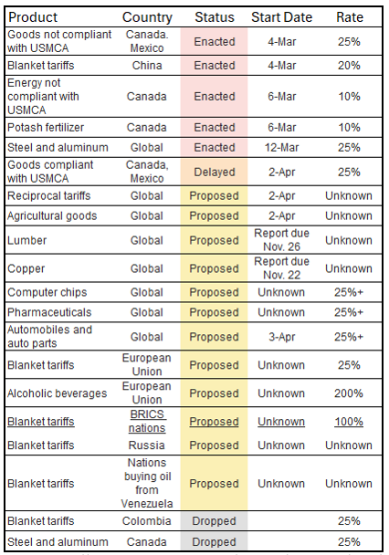
White House policy is fluid
Source: https://www.washingtonpost.com/business/interactive/2025/trump-tariffs-enacted-effect-threatened/ (Table)
Source Freepik (Whitehouse Graphic)
Notes:
https://www.washingtonpost.com/business/interactive/2025/trump-tariffs-enacted-effect-threatened/
Now that we’ve put more context to what tariffs are and why they’re typically used, let’s take a look at how tariff policy has evolved under the second Trump administration
As of the end of Q1, there were multiple tariffs enacted and proposed and include a number of country and product specific tariffs as well as broader blanket policies. It is important to note all of the information discussed here re: tariffs is prior to April 2, or what President Trump referred to as Liberation Day, when he imposed sweeping tariffs on imported goods from all nations.
White House policies regarding tariffs have proven to be fluid during the beginning of the second Trump administration. This graphic details a list prior to April second of tariffs that had been either proposed, enacted, or canceled as directed by the White House.
It is not only the tariffs that can cause issues but the uncertainty of the on-again, off again nature of the policies that causes issues for businesses, and possible slower growth in the future. We have seen words like erratic, whipsaw, and unpredictable to describe the tariffs, and we know markets do not like uncertainty.
Markets have paid attention to this evolving narrative, which have increased volatility in both stock and bond markets so far this year.
Ultimately, the outcome of these tariffs will depend on their duration and magnitude.

Slide 6
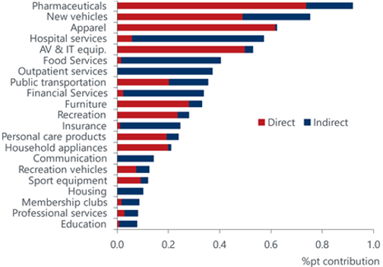
Where tariffs will be felt first
Source: Oxford Economics/Haver Analytics
Notes:
https://www.bostonfed.org/publications/current-policy-perspectives/2025/the-impact-of-tariffs-on-inflation#:~:text=Imports%20Account%20for%20an%20Estimated,spending%20on%20food%20and%20energy.
While there’s still much uncertainty around the timing and magnitude of a number of these proposed tariffs, many economists anticipate an increase in the prices consumers pay for these affected goods and could likely keep upward pressure on inflation
This chart displays the percentage contribution to the Fed’s preferred measure of inflation, the core personal consumption expenditures Index or Core PCE, by different spending categories.
It also bifurcates between measures of direct imports, meaning the share of goods and services wholly imported from abroad, and by indirect imports, meaning the share of goods and services whose components are imported.
A study published on 2/6/25 by the Boston Fed suggested that a 25% tariff on Canada and Mexico with a 10% tariff on China could add between 0.5% and 0.8% to core PCE inflation
This implies that inflationary measures could increase with these tariffs

Slide 7
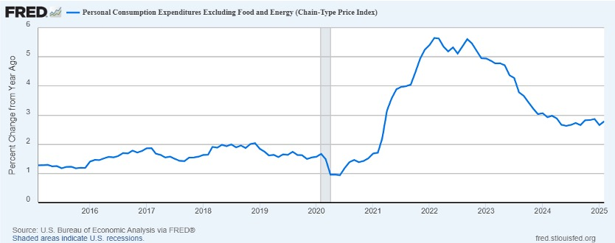
Inflation Remains Stubborn
Notes:
●Because these tariff policies are still quite new and some have yet to be enacted, we haven’t seen an upward spike in inflation
●However, as we can see on this chart, inflation has proven to be sticky as of late, giving further credence to Fed Chairman Jerome Powell’s guidance that the last mile of lowering inflation from 3% to 2% would be an ongoing battle.
●The potential effect of tariff policy could make this even more challenging.
●In order for the Fed to continue lower interest rates, we would likely need to see a material downgrade in economic growth or the U.S. labor market, both of which have remained resilient up until now.
●Latest reading for Core PCE: Feb 2025: 2.8%

Slide 8
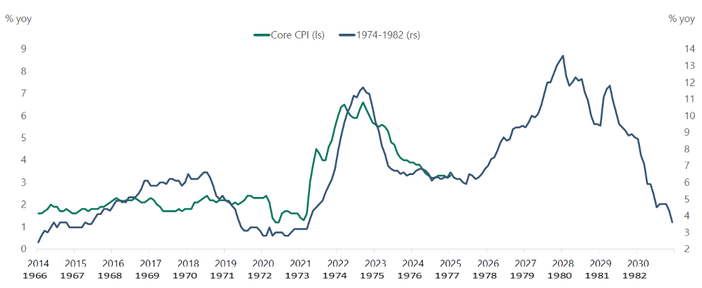
Back to the 70s?
Source: BLS, Bloomberg, Apollo Chief Economist
Notes:
●Here we plot the inflation rate from 2014 through present as measured by the green line against the path of inflation from the late 1960s through the early 1980s measured by the blue line, often referred to as “The Great Inflation” which ushered in an era of stagnant economic growth and high inflation.
●The inflation trajectory of these two time periods look eerily similar, but their underlying causes are not quite the same. The first was caused by a multitude of factors including an oil supply shock, the removal of the Gold Standard, and expansionary monetary and fiscal policy.
●Today’s environment is much different, but the stakes are just as important. If inflation were to accelerate again as it did in the late 70s and the unemployment rate were to take off, the Fed would be in a difficult position.

Slide 9
Notes:
●Speaking of the Fed being in a difficult position….
●Ideally, the Fed would like to lower rates due to good news, like seeing inflation decline
●However, they can also lower rates due to bad news, like challenging economic conditions (think the Great Recession or Covid)
●Tariffs could prove to be inflationary ( where the Fed would prefer to raise rates) but could also be a factor in weakening economic growth (where the Fed would want to lower rates). Similarly, if unemployment worsened, the Fed could potentially lower rates. As stable prices (i.e. low inflation) and low unemployment are both of the Fed’s mandates, it’s difficult to know which one they would focus on if they are giving opposite signals.

Slide 10
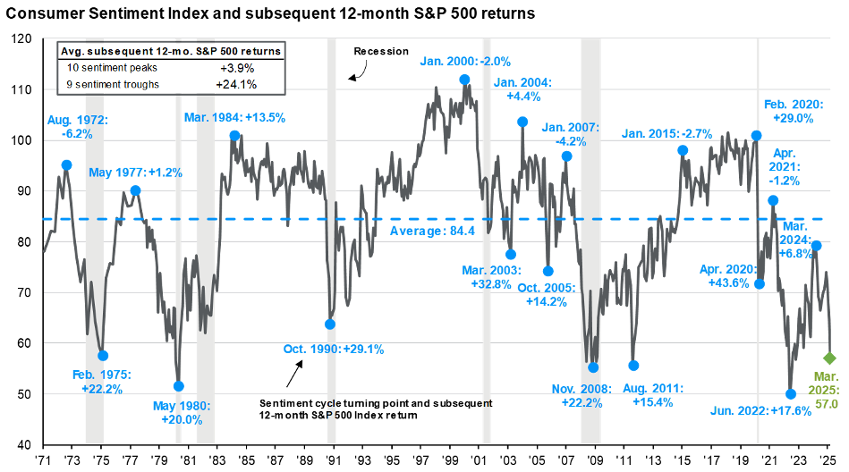
Is low consumer sentiment a good sign for stock returns?
Notes:
●All of this macroeconomic and policy uncertainty has begun to further weigh on the U.S. consumer
●This chart displays the University of Michigan Consumer Sentiment index, which you can see has declined.
●Declining consumer confidence can be an issue because it can be a precursor to declining consumer spending, which we will show on the next page.
●At the same time, the chart also shows S&P 500 returns have been significantly higher in the 12 months after sentiment hits a trough than it is when consumer sentiment peaks (we may be at or near one of those points now).
●Indicators of consumer sentiment and consumer confidence (both of which are in decline) are similar in that they measure the mood of consumers and their overall willingness to spend money.

Slide 11
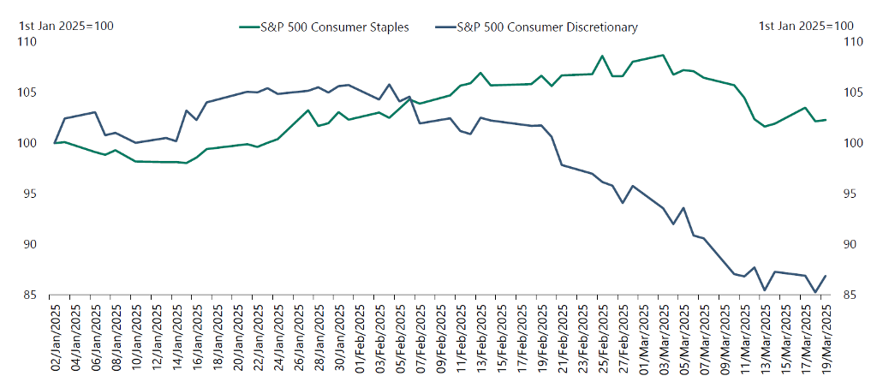
Will consumer spending decline?
Source: Bloomberg, Apollo Chief Economist
Notes:
●And negative sentiment is one thing, but when it flows through to markets, that’s another thing altogether.
●While the previous chart pointed out how consumers are feeling, this chart paints a picture of how consumers are expected to alter their spending habits between must-have items and nice-to-have discretionary products.
●And as we can see, the S&P 500 basket of stocks for consumer discretionary companies has declined significantly in recent weeks, suggesting that investors are starting to worry about future consumer spending on big-ticket items such as cars, washing machines, and mobile phones.
●Consumer spending is an important economic metric because it constitutes roughly 2/3 of GDP.
●While the last few slides display recent trends, we know that like markets, economic trends can change with magnificent speed and magnitude. We also know that the market is forward looking while many economic indicators are backward looking.
●This highlights two key investment concepts: 1.) because many economic indicators are backward looking and markets are forward looking, it’s very difficult to make market timing decisions based on those economic indicators. 2.) And that the future holds a wide range of possible outcomes, and because of that, diversification is essential.

Slide 12
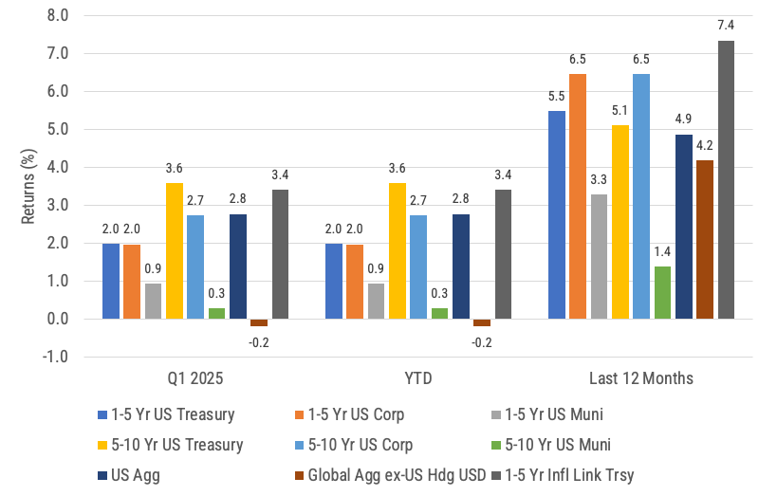
Global Bond Returns
Source: Morningstar, Bloomberg and ICE BofA ML benchmarks shown. Past performance is not indicative of future results.
Notes:
Now let’s take a look at how different segments of the global bond market fared in Q1.
US bond returns were all positive for the first quarter. Only non-US bonds (hedged USD) fell slightly, returning -0.2%.
Over the last three months, Treas/Corp returns have outpaced munis. Our friends at iShares shared with us the divergence in Treas/Corp vs. munis "is largely driven by yield curve reshaping in the Muni market, with long-term yields increasing." Munis have also been negatively impacted by "widening credit spreads, seasonal weakness, and heavy issuance.“
All bond returns shown are positive over the last 12 months with ST TIPS earning the most at 7.4%,owed to declines in short term Treasury yields as we’ll see on the next page, plus the inflation adjustment.

Slide 13
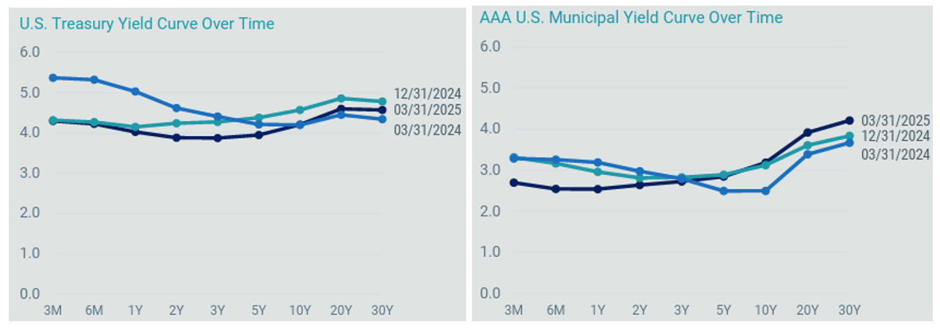
Yield Curve Changes
Notes:
On this slide, If we focus on the chart on the left first, we will see that compared to year end, short term rates (which the Fed controls) stayed the same over the quarter while longer term yields fell slightly. You can also see that there is still some inversion on the shorter and intermediate parts of the curve end but not on the longer ends. Short-term yields dropped over the 12-months ending March 31, hence the positive short term bond returns on the previous page.
The chart on the right is the muni curve. Importantly, you can see it is shaped differently from the Treasury curve. Different factors drive each market, so it highlights how each type of bonds can move differently at various times for different reasons. The muni curve shows that shorter term yields fell over the quarter but longer term yields rose. Munis have also been negatively impacted by widening credit spreads, seasonal weakness, and heavy issuance, which also negatively impacted returns.

Slide 14
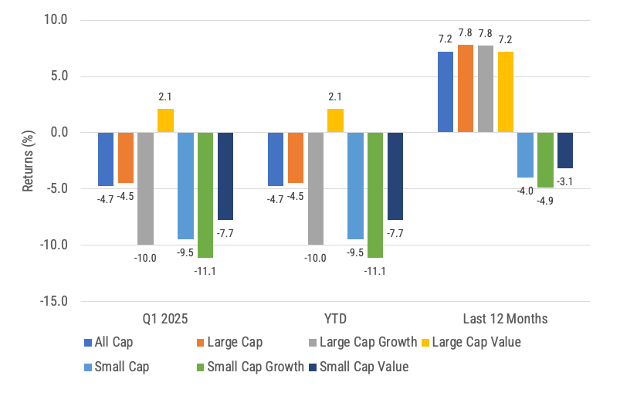
US Stock
Returns by
Size and Style
Source: Morningstar, Russell benchmarks shown. Past performance is not indicative of future results.
Notes:
Now, let’s take a look at the quarter’s performance for U.S. stocks.
US stocks were mostly negative for Q1 with the exception of large cap value. Uncertainty around tariffs and trade wars continued to weigh on US stocks across the market cap and valuation spectrum. Large cap growth fell -10% YTD.
Over the last 12 months, large cap stocks across the valuation spectrum all returned over 7% while small cap stocks fell between -3 to -5%.

Slide 15
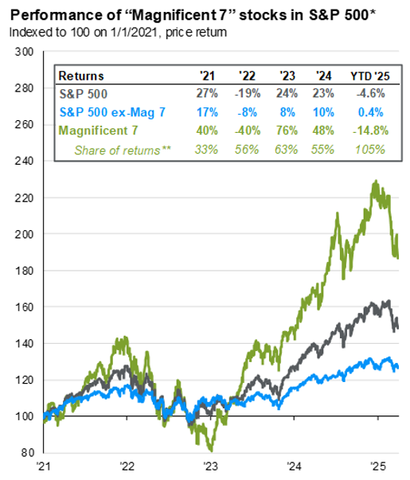
Less than magnificent so far…
Source: FactSet, Standard & Poor’s, J.P. Morgan Asset Management. *Magnificent 7 includes AAPL, AMZN, GOOGL, META, MSFT, NVDA and TSLA. Earnings estimates for 2025 are forecasts based on consensus analyst expectations. **Share of returns represent how much each group contributed to the overall return. Guide to the Markets – U.S. Data are as of March 31, 2025.
Notes:
●Relating to the prior slide, here we show the returns of the Magificient 7 stocks, which represent approximately 30% of the S&P 500 as of 3/31/25
●You don’t have to look further back than 2023 and 2024 to see periods where these stocks skyrocketed overall, but more recently, they’ve begun their descent back toward Earth.
●This has weighed on U.S. stocks this quarter, though if you look at the other 493 stocks in the S&P 500, they actually had a positive overall return over the quarter.

Slide 16
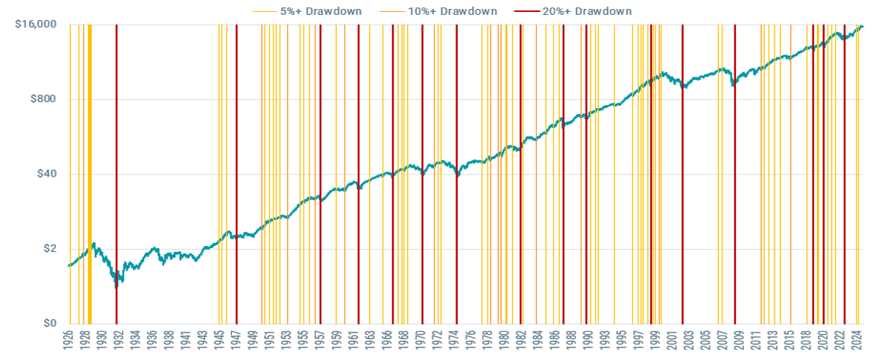
Past downturns and long-term performance
Growth of $1 in U.S. stocks through market drawdowns since 1926
Returns data from 7/1/1926 – 3/6/2025. U.S. stocks sourced from the Center for Research in Security Prices (CRSP) include all firms incorporated in the US and listed on the NYSE, AMEX, or NASDAQ. Drawdowns are calculated from market peaks to subsequent bottoms. Past performance is no guarantee of future results. This hypothetical situation contains assumptions that are intended for illustrative purposes only and are not representative of the performance of any security. There is no assurance similar results can be achieved, and this information should not be relied upon as a specific recommendation to buy or sell securities.
Notes:
●Speaking of negative performance, Volatility and market pullbacks are not enjoyable to experience and that is why its important to keep a long-term mindset
●This chart details a growth of a dollar in the U.S. market from 1926 through the end of last year with an overlay of 5-10%, 10-20%, and 20%+ drawdowns.
●This tells us two things:
1. drawdowns are common and are to be expected. It doesn’t necessarily make them easy to deal with, but we need to keep the possibility of short-term losses in mind when investing
2. No matter the level or persistence of these drawdowns, history shows us that markets appreciate in value over time, and that the only way to be rewarded for the risk we take is by staying invested

Slide 17
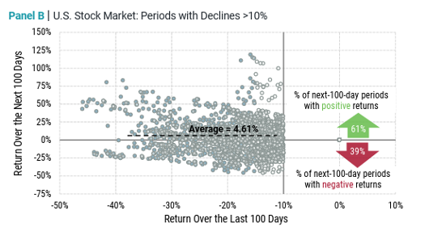
Recent returns don’t predict future returns
Source: Avantis Investors, data from 7/1/1926 – 2/28/2025. US stocks sourced from the Center of Research in Security Prices (CRSP) include all firms incorporated in the US and listed on the NYSE, AMEX, or Nasdaq. Past performance is no guarantee of future results.
Notes:
●Investors see the sentence that “past performance is no guarantee of future results” all the time. In fact, it’s even part of the disclaimer for this slide.
●But too often we hear that investors don’t follow this mantra. In good markets, investors expect the good times to continue and when markets are down, investors often have a hard time seeing the sunny skies ahead.
●Using nearly a century of data, this chart aims to provide context for how returns over the next 100 days are when the previous 100 days return was a decline of > 10%. What we see is that the majority of time (61%) the return was positive in the 100 day period that followed. It’s certainly not all sunny skies and smooth sailing, but it’s not necessarily all dark clouds either.

Slide 18
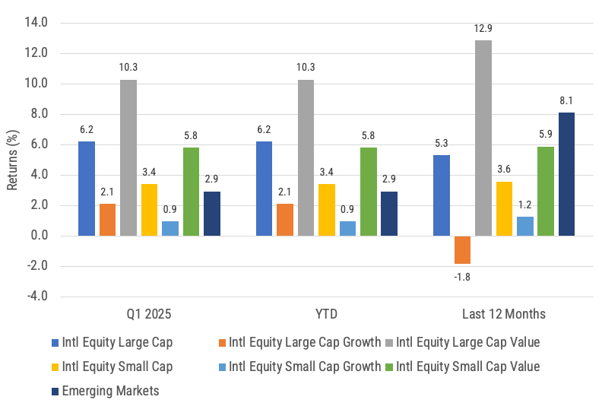
International developed and emerging market stock returns
Source: Morningstar, MSCI benchmark shown. Past performance is not indicative of future results.
Notes:
Non-US stocks on the whole had returns in the positive territory for the quarter and with the exception of intl developed large cap growth, the non-US stock indexes we cover were all positive for the last 12 months too.
Intl. large cap stocks gained 6.2% YTD, outperforming their US large cap stock counterparts (e.g. R1000) by 10.9% over the last three months while Intl. large cap value and intl. small cap value have added 10.3% and 5.8% respectively on a YTD basis.
Interestingly, Intl large cap value has outperformed US large cap growth by over 20% YTD.
The returns of non-US stocks over the recent months highlight the value of diversification.

Slide 19
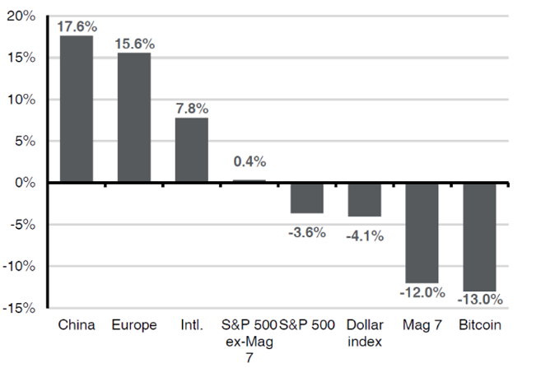
Policy uncertainty weighing on U.S. exceptionalism
Price Index returns, USD, year-to-date as of 3/21/25
Source: Bloomberg, FactSet, J.P. Morgan Asset Management. Data are as of March 21,2025
Notes:
●Relating back to the last slide, markets have now begun to question the exceptional 15+ year run that the U.S. market has had relative to its global peers. Although one quarter is less than a drop in the bucket relative to history, intl stocks have clearly been additive to a portfolio so far YTD.
●The winners of the prior decade: the S&P 500, the Magnificent 7 stocks, Bitcoin, and the U.S. Dollar have weighed on global market performance YTD.

Slide 20
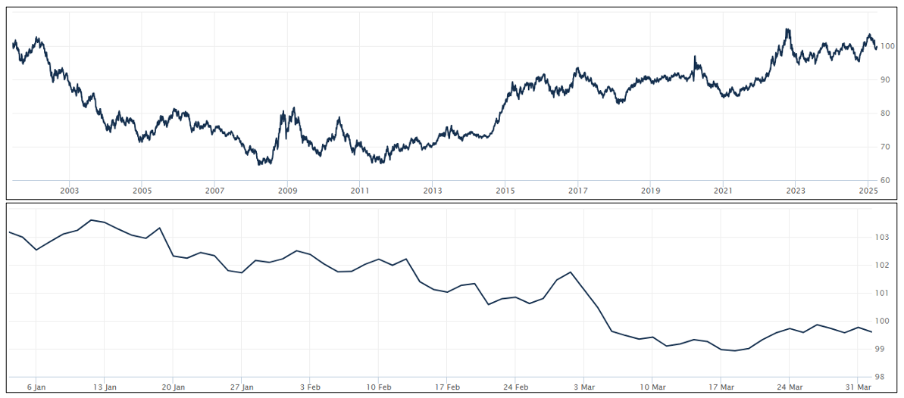
Dollar Strength is Good for US Consumers, Bad for Owners of Non-US Investments
Source: Wall Street Journal as April 1, 2025. Past performance is not indicative of future results.
Notes:
WSJ’s Dollar Index (BUXX) represents the value of the USD relative to a basket of 16 foreign currencies.
A rising dollar is generally good for US consumers as it makes foreign goods cheaper to purchase, but bad for owners of non-dollar-denominated assets, such as foreign stocks. Said differently, a strong dollar hurts international returns. A strong dollar also hurts US exports and therefore can also negatively impact US production and employment.
The top chart shows the movement over the last 20+ years for longer term trends while the bottom chart shows the last 3 months where the dollar rose. The top chart shows the dollar is currently still stronger than most other time since the inception of this WSJ Dollar Index. A US Dollar decline would be a tailwind for non-US equity returns vs. US equities, the opposite is also true. The bottom chart shows the USD weakened over Q1 2025.

Slide 21
Maintain your focus on what really matters
Financial planning is a process, not an endpoint
Concentrate on long-term goals and objectives
Focus on reaching goals, not on beating benchmarks
Maintain a disciplined approach, in good and bad markets
Invest broadly and globally; asset allocation is key
Reduce investment and tax costs where possible
Rebalance as necessary
Notes:
Do investments matter? Of course they do; however it is not investments alone that will help you achieve your goals. Maintaining a focus on these bullet points is what really matters in helping you achieve your goals.

Slide 22
Questions?

Slide 23
Disclosures
This information is not intended to be used as the primary basis for investment decisions, nor should it be construed as advice designed to meet the particular needs of an individual investor. Investing in mutual funds, ETFs, and other equity and debt securities involves risk, including loss of principal. An investor should consider a portfolio’s investment objectives, risks, and expenses carefully before investing. Please read any applicable funds’ prospectus carefully before investing. Investors cannot invest directly in an index. Indexes are unmanaged and reflect reinvested dividends and/or distributions, but do not reflect sales charges, commissions, expenses or taxes.
XYPN Invest constructs and manages investment models (“Model Portfolios”) through a technology solution. The Model Portfolios can be used by investment adviser representatives (“IARs”) of XYPN Invest, an SEC registered investment adviser (“RIA”), as well as IARs of other unaffiliated RIAs (“iIARs”). iIARs are members of XYPN, but not affiliated with the XYPN Invest RIA. XYPN Invest manages its Model Portfolios on a discretionary basis primarily by allocating assets among various mutual funds and exchange-traded funds (“ETFs”). XYPN Invest may allocate to individual securities in certain circumstances. IARs and iIARs are ultimately responsible for choosing the appropriate Model and overall allocations for their Clients.

