Slide 1
2024 Q3
Quarterly Market Review
Presented By: Mario Nardone, CFA

Slide 2
2024 Q3
Quarterly Market Review
Positive Signals
Reasons for Concern
Inflation (CPI) fell to 2.6% in August, providing the Fed cover to decrease the Fed Funds rate.
Recessionary indicators are not flashing red.
Parts of the yield curve have un-inverted (e.g. normalized to upward sloping), meaning bond investors are being compensated for term risk.
The Fed’s concerns have shifted from inflation to the labor market. Unemployment rose slightly to 4.2% in August.
Geopolitics and the upcoming US election have some investors’ nerves frayed.
Will China follow through on the stimulus packages and will they be enough to boost consumer confidence and bolster their property market?
Notes:
As always, we like to take a balanced approach to looking at the global economy and markets, not reacting too positively or negatively to any news.

Slide 3
2024 Q3 By the Numbers
4.75% - 5.00% is the new Fed policy rate as it pivoted lower by 50 bps in September. The Fed is trying to engineer a soft landing, which is an environment with low inflation and low unemployment.
2.6% and 2.2% were the August 2024 headline CPI and PCE figures, below the 3.3% and 2.6% figures from May, allowing the Fed to reduce the Fed Funds rate.
26 is the number of months the yield curve was inverted (measuring the spread between 2 and 10 yr Treasuries). Note that short term rates are still inverted.
3.2% was the Russell 1000 Growth index return for Q3, the lowest return of US equity indexes we track for the quarter, and also lower vs. international indexes.
15.9% was the DJ Global Select REIT index return for Q3, the highest returning index over the quarter we track.
35.8% is the amount the top ten stocks in the S&P 500 comprise from a market capitalization perspective; slightly lower vs. last quarter but still high and considered relatively concentrated.

Slide 4
It’s all about the Fed’s pace, pause, & pivot
Source: Morningstar Direct, ACWI was the ETF used to replicate the MSCI ACWI, data as of June 13, 2024. Chart looks at the 50 companies with the highest YTD return. Past performance is not indicative of future results.
Notes:
The Fed has finally moved to the “pivot’ stage.
We have often talked about the Fed’s dual mandate of maintaining stable prices and having full employment. In an effort to combat high and rising inflation back in 2022, the Fed kept up a rapid pace of increasing the Fed Funds rate with the explicit goal of slowing inflation. We spoke about how it would take some time for these increases to work their way through the financial and economic system and how in August of 2023, the Fed was finally able to hit the pause button on rate increases. Since the summer of 2023 there has been a debate on when the Fed would pivot and start lowering rates. In December 2023 predictions were the Fed would pivot soon and that rates would decline throughout 2024. As an aside, this is exactly why we don’t base our investment approach on predictions, because we know they are often wrong, as they were in this case.
Fast forward to September of 2024 when the Fed finally pivoted to lowering rates, cutting the Fed Funds rate by 50 bps. Part of what made this rate cut so interesting is that while the Fed was previously focused on inflation, Fed Chairman Powell’s remarks indicate the Fed’s main concerns had clearly shifted from inflation, which has been cooling, to the labor market, which has begun to soften.
Now that the Fed has made this initial cut, the next questions relate to the Fed’s next move. How low will rates go? Chairman Powell said he doesn’t think we are going back to ultra-low interest rates. When will the next rate cut be? How large will it be? The Fed will continue to be data dependent when it comes to making future decisions regarding any additional rate changes.

Slide 5
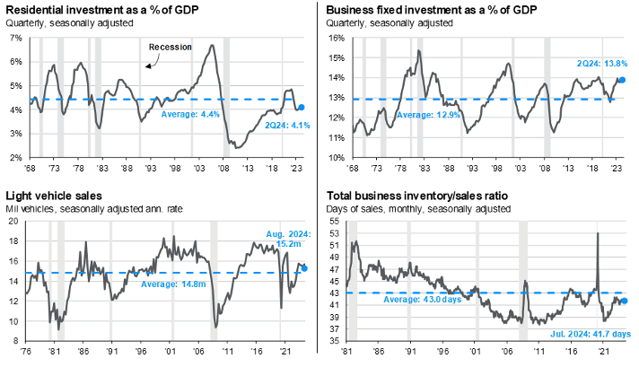
Are we headed for a recession?
Source: BEA, Census Bureau, FactSet, J.P. Morgan Asset Management. Data for light vehicle sales is quarterly apart from the latest monthly data point. JPM Guide to the Markets – U.S. Data are as of September 30, 2024.
Notes:
Why do most economists think we are not headed for a recession right now? These 4 boxes show 4 cyclical indicators and typically at least one of them has failed in previous recessions; as they show, there does not appear to be trouble bubbling up in any of them. Plus, consumers have continued to spend, supporting economic growth.

Slide 6
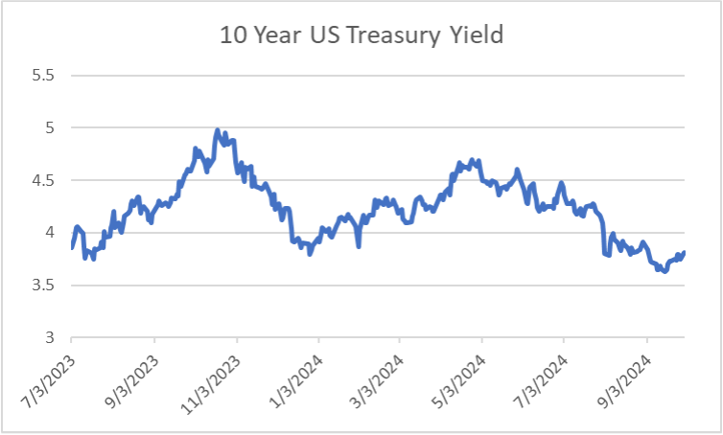
How do US bonds perform after a Fed rate cut?
Source: US Department of the Treasury
Notes:
As it relates to bonds, while the Fed’s decision impacts the short end of the yield curve (i.e. cash), the rest of the yield curve is driven by market expectations. With the Fed initiating a rate decrease in September, investors still sitting in cash need to prepare to see the interest rates they are receiving decline.
At the same time, we wouldn’t suggest making too many changes simply based on watching what the Fed does. This chart shows the change in the 10 year US Treasury yield from July 2023 through September 24. Throughout this 14 month period, there were multiple FOMC meetings where the Fed didn’t change the Fed Funds target. And as the chart shows, there have been upward and downward shifts in the 10 yr Treasury. In other words, the return of the 10 yr Treasury is more based on future market expectations than it is based on the movement of the Fed Funds rate.
What is also interesting to note is that the 10 yr US Treasury yield actually increased by 16 bps (3.65% to 3.81%) from the night before the Fed’s decision through month end. Why did it increase rather than decrease? This somewhat unexpected shift could be the result of investors believing the risks of a recession in the US decreased due to the 50 bps rate cut, meaning investors are less interested in owning Treasuries, so Treasury prices decreased (and yields move inversely with prices).
Where are rates headed from here? As you know, we are not in the business of making predictions, but we do have an understanding of how markets work. It all depends on expectations. Where we currently sit with a relatively strong economy and a small risk of recession, it is possible that yields may not decline much further. This is because the possible future impact of rate cuts has already been priced into the market. That being said, if a recession were to occur, then we would likely expect to see yields decrease on the 10 yr Treasury.
Finally, it is important to note that high quality corporate bonds are expected to outperform their Treasury counterparts over time.

Slide 7
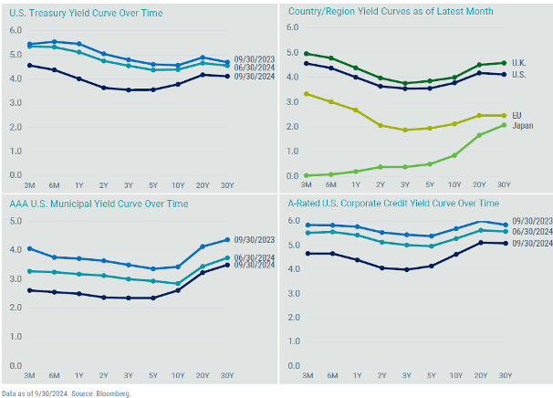
Stories from global yield curves
Data as of 9/30/2024. Source: Bloomberg
Notes:
This is a set of charts we often include because they offer several good stories to tell.
US Treasury rates declined across the entire yield curve (top left) vs. last quarter end. Interestingly, while short term rates are still above long term rates, the curve has actually uninverted between 2 yr and 10 yr Treasuries (these are the maturities most often referenced when talking about yield curve inversion).
The corporate curve on the bottom right shows there is some added yield benefit potential from being invested in A-rated corporate bonds vs. their Treasury counterparts.

Slide 8
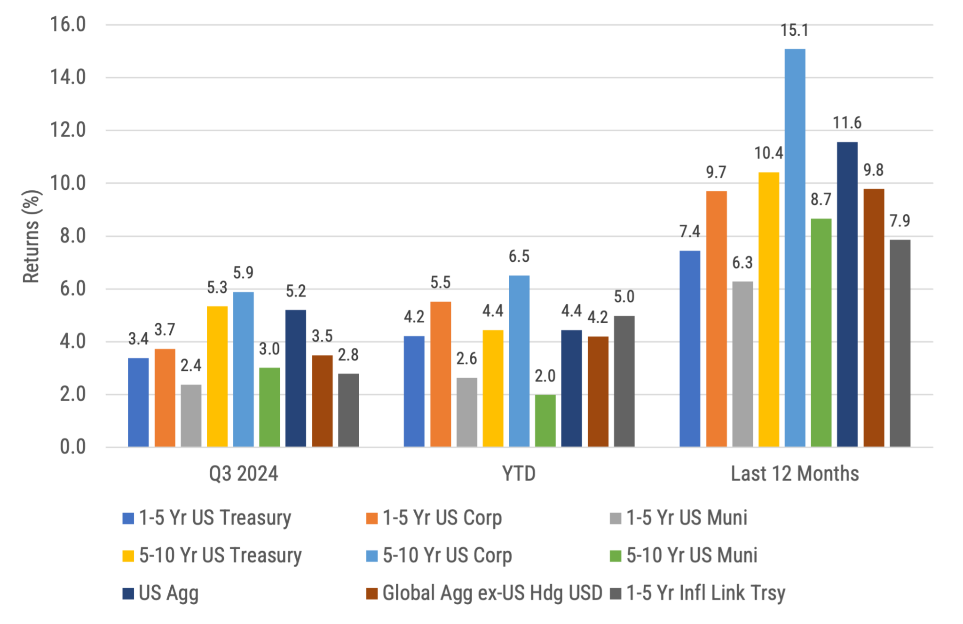
Global
Bond Returns
Source: Morningstar, Bloomberg and ICE BofA ML benchmarks shown. Past performance is not indicative of future results.
Notes:
Bond returns were all positive for the second quarter. Treasury rates fell across the entire yield curve in varied amounts with the 1 month Treasury falling 54 bps, the 1 yr fell 111 bps, while the 10 yr Treasury declined 55 bps. Corporates fared better vs. Treasuries over the time periods shown. Non-US bonds (hedged to the USD) continue to be a positive contributor, having returned 9.8% over the last 12 months.

Slide 9
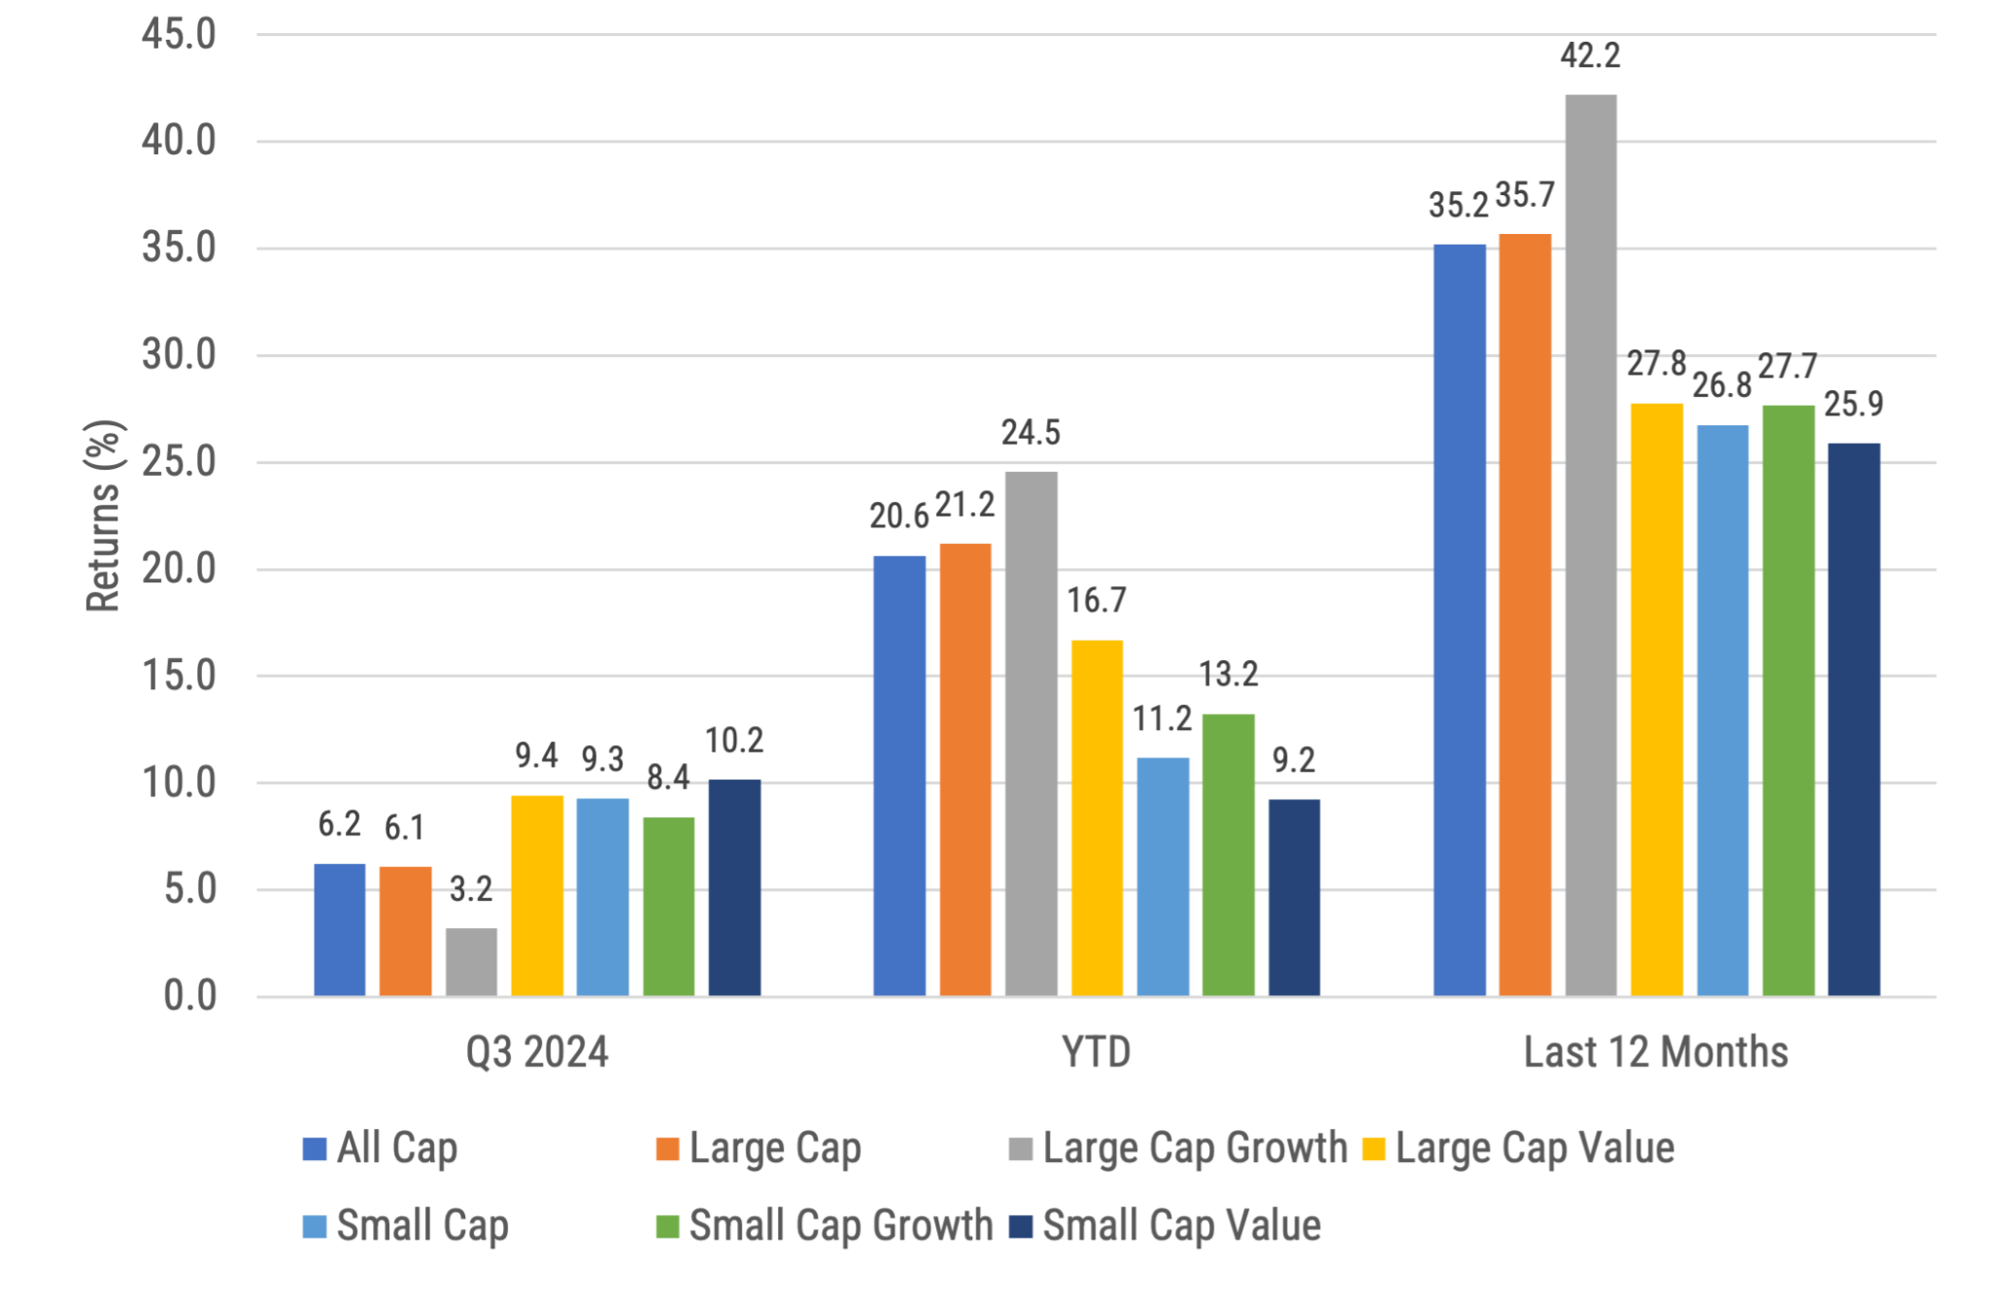
US stock returns by size and style
Source: Morningstar, Russell benchmarks shown. Past performance is not indicative of future results.
Notes:
US stocks were all positive over the quarter, YTD, and all have returns > 25% over the last 12 months. Interestingly, while many investors have been focused on growth and tech, the R1000G was actually the lowest performing US equity index over the last 3 months.
It is important for clients to recognize how strong these YTD and 1 yr returns are. Specifically, on a historical basis, the average annual return for the S&P hovers around 10% so each of these asset classes are already well over this over the last 12 months. Of course we have no way to know whether that will continue.

Slide 10
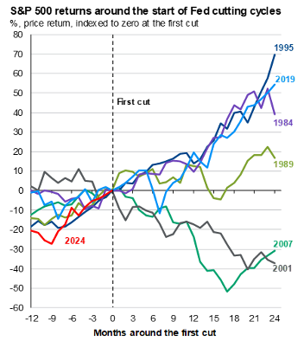
How do US Stocks perform after a Fed Rate Cut?
Source: FactSet, Federal Reserve, LSEG Datastream, S&P Global, J.P. Morgan Asset Management. Past performance is not a reliable indicator of current and future results. Excludes 1998 episode due to the short length of the cutting cycle and economic context for the cuts. Guide to the Markets – U.S. Data are as of September 30, 2024.
Notes:
With the Fed decreasing rates, a common question is “how do US stocks perform after a Fed rate cut?” It’s a fair and good question, though the answer is it depends on why the Fed is cutting rates in the first place.
This chart shows that the S&P 500, which we will use as a proxy for US stocks in this instance, has moved differently over various periods following rate hikes.
In the scenario where the Fed is cutting rates because there are economic concerns and challenges (think of the dot-com bust of 2001 or the Great Financial Crisis in 2007), it is not surprising that equity markets can fall following a rate cut.
However, when the Fed is cutting rates because of what is deemed more positive news like falling inflation, it is possible US stock markets will increase. Plus, lower interest rates should make stocks more attractive relative to bonds, which can also serve to increase the value of stocks.
Does this mean you want to load up on US stocks now that the Fed has lowered rates? Not necessarily. Regardless of several valuation measures we can look at (e.g. P/E, CAPE, P/B), current US stock valuations show as overvalued vs. their last 30 yr average. This is another example of why we don’t try and time the markets.

Slide 11
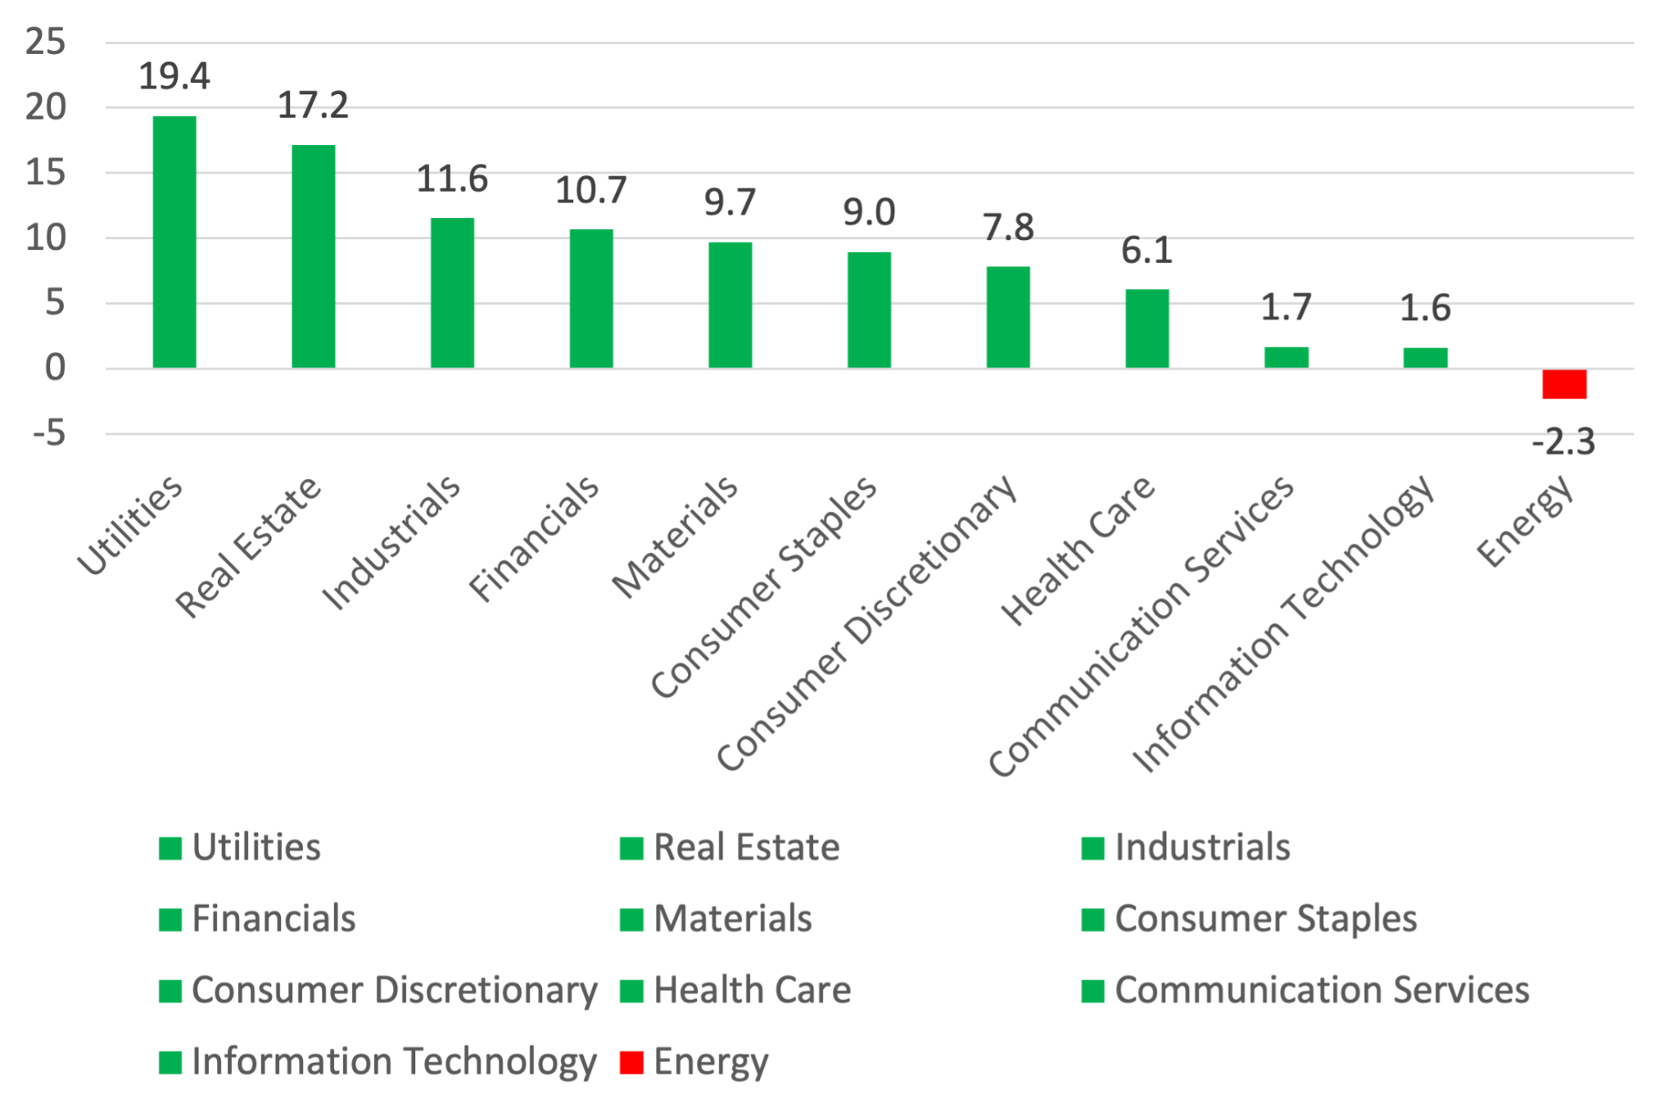
US Tech Lagged in Q3
Source: S&P, data as of September 30, 2024. Past performance is not indicative of future results.
Notes:
While the information technology sector dominated the S&P in Q2, it was a laggard in Q3, returning only 1.6% relative to sectors like Utilities (+19%) and Real Estate (+17%).
Similarly, while excitement behind artificial intelligence (AI) drove markets considerably higher earlier this year, there is now at least some concern that the level of spending on AI by the major players is not only unsustainable, but it has investors wondering if/when/how these bets on AI will ultimately be profitable.

Slide 12
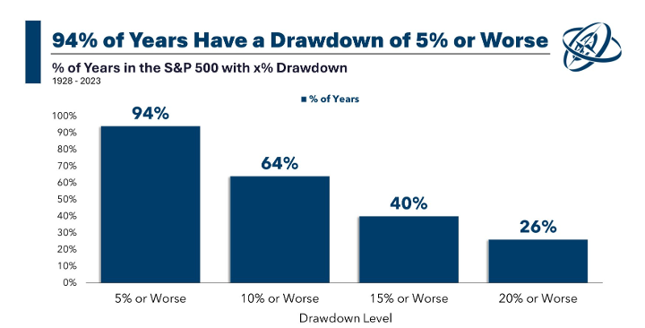
Source: Ritholtz Wealth Management. Past performance is not indicative of future results.
Notes:
While US equity markets were up over the quarter, we did see a broad market selloff in early August that could have been caused by a number of factors including the Yen carry trade, belief the Fed may have waited too long to cut rates, skepticism about the growth of AI, among other possible causes.
So, while we expect markets to go up over time, let this chart serve as a reminder that markets don’t go up all the time. In fact, history tells us that the US stock market is positive roughly 3 out of every 4 years, or 75% of the time. However, as this chart shows, 94% of years experience a drawdown at some point over the year of 5% or more. And almost 2/3 of the time, there is a drawdown of over 10% or more.
In other words, investors should expect these periods to come fairly regularly and we wouldn’t suggest changing your investment approach when they do come.

Slide 13
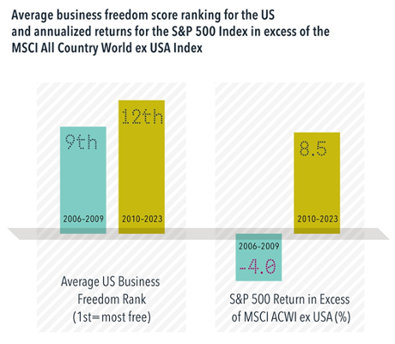
Has the US market performed well because it’s business friendly?
Past performance is not a guarantee of future results. Actual returns may be lower. Annual quintile rankings computed using business freedom scores from the Heritage Foundation. MSCI data © 2024, all rights reserved. S&P data © 2024 S&P Dow Jones Indices LLC, a division of S&P Global. Indices are not available for direct investment. Their performance does not reflect the expenses associated with the management of an actual portfolio.
Notes:
We know the US has outperformed non-US stocks over the last 10-15 years overall and there are a lot of theories as to why it has happened. One of the prevalent theories is that the US is simply friendlier to businesses.
The Heritage Foundation’s business freedom scores rank countries by four broad categories including rule of law, government size, regulatory efficiency, and open markets.
The US finds itself around the middle of the pack, ranking 13th out of 22 developed countries in 2023.¹
More relevant than the level is the consistency of the US’s ranking, and this poses a major challenge to explaining recent US market performance through business freedom. The US’s average ranking from 2006 through 2009 was about ninth. During the years since 2010, the average ranking fell slightly to twelfth. So, the US’s business appeal was essentially middle of the pack both during the back end of the “lost decade” and from 2010–2023. And yet, the S&P 500’s relative return outcomes were polar opposite during these two periods, flipping from underperforming the MSCI All Country World ex USA Index by 4.0 percentage points to outperforming by 8.5 percentage points. This data casts doubt on the theory the US has done well because it is more business friendly.
1. The World Bank’s Ease of Doing Business score placed the US among the top 5 of developed markets in its last production, but the series was discontinued in 2021.

Slide 14
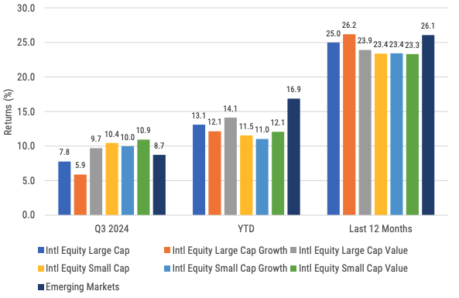
International developed and emerging market stock returns
Source: Morningstar, MSCI benchmark shown. Past performance is not indicative of future results.
Notes:
Outside the US, all developed and emerging markets indexes were positive for the quarter, outpacing their US counterparts.

Slide 15
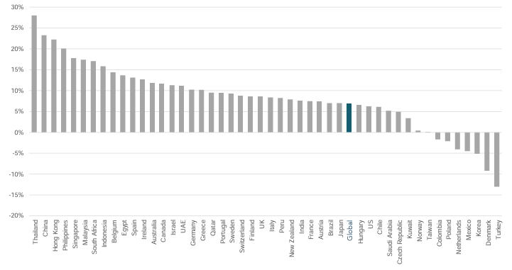
Developed and emerging markets outperformed the US in Q3
Past performance is no guarantee of future results. Country returns are the country component indices of the MSCI All Country World IMI Index for all countries except the United States, where the Russell 3000 Index is used instead. Global is the return of the MSCI All Country World IMI Index. MSCI index returns are net dividend. Indices are not available for direct investment. Their performance does not reflect the expenses associated with the management of an actual portfolio. Frank Russell Company is the source and owner of the trademarks, service marks and copyrights related to the Russell Indexes. MSCI data © MSCI 2024, all rights reserved.
Notes:
During Q3, US markets were beaten by both ex-US developed and emerging market indexes overall.
Let’s pay particular attention to China, as it was the second highest returning country over the quarter. China has outsized importance when it comes to emerging market returns, simply because it assumes roughly 25.7% of the emerging market index, its largest country weighting (India and Taiwan are next at 24.9% and 21% respectively). Source: VWO ETF
The return in China came in late September after the Peoples Bank of China announced a significant stimulus package that would cut interest rates, provide support for the property market, and looks to boost low consumer confidence. Will China follow through and will it be enough to sustain the recent stock market performance in China?
Non-US country returns were also broadly aided by a US dollar that fell relative to a basket of other currencies.

Slide 16
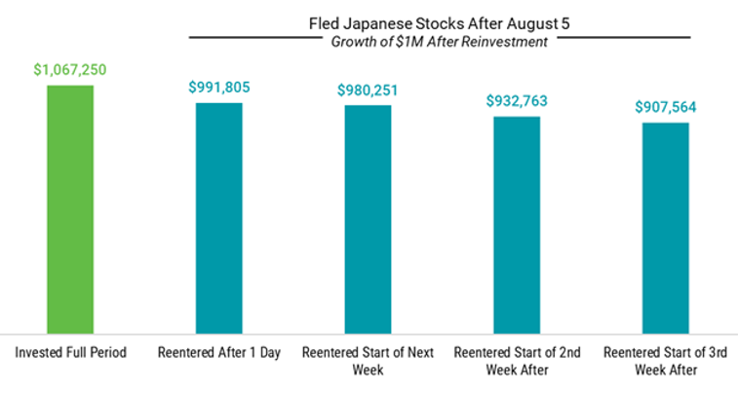
Don’t time the market!
Past performance is not indicative of future results.
Notes:
In early August, we saw the Nikkei stock index drop by more than 12% in a single day. When these events occur, it is common for investors to ask the following questions:
The first question is “how much exposure do I have to Japanese stocks?” Obviously, it depends on each client’s individual portfolio but let’s make the assumptions that it’s a portfolio that has a 60% equity weighting. If we then assume the client’s allocation to Japan is equal to the current market cap of 5%, then the client has 3% exposed to Japanese stocks. If you put this in dollar terms and assume a $1M portfolio, the weighting to Japan is $30K. ($1M x 60% x 5%)
The second question is “should I continue to invest in Japanese stocks?” Assuming that you are invested in a broadly diversified non-US equity fund/ETF, there is really no way to remove the Japanese exposure. But more importantly, if you look at the chart above it clearly shows that investors would have been better off staying invested in Japanese stocks vs. trying to time the Japanese stock market.

Slide 17
Dollar strength is good for US consumers but bad for owners of non-US investments
Source: Wall Street Journal as October 1, 2024. Past performance is not indicative of future results.
Notes:
WSJ’s Dollar Index (BUXX) represents the value of the USD relative to a basket of 16 foreign currencies.
A rising dollar is generally good for US consumers as it makes foreign goods cheaper to purchase, but bad for owners of non-dollar-denominated assets, such as foreign stocks. Said differently, a strong dollar hurts international returns. A strong dollar also hurts US exports and therefore can also negatively impact US production and employment.
The top chart shows the movement over the last 20+ years for longer term trends while the bottom chart shows the last 3 months where the dollar rose. The top chart shows the dollar is currently still stronger than most other time since the inception of this WSJ Dollar Index. A US Dollar decline would be a tailwind for non-US equity returns vs. US equities, as it was in Q3. A possible reason for this is that the Fed decreased interest rates, reducing the appetite for US investments (however, some other central banks have also lowered rates), stemming flows into USD-denominated assets.

Slide 18
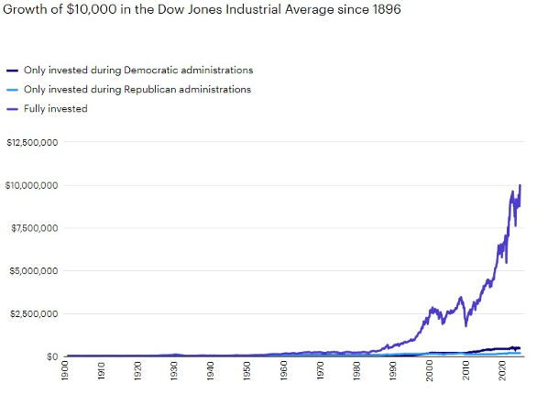
Stay invested, regardless of your political views
Sources: Haver, Invesco, 12/31/23. The Dow JOnes Industrial Average is a price-weighted index of the 30 largest, most widely held stocks traded on the New York Stock Exchange. An investment cannot be made in an index. Past performance does not guarantee future results.
Notes:
With the election upon us, we wanted to share this chart with you. We understand that regardless of which party you affiliate with, it is possible you have very strong opinions against the other party. However, we would suggest not changing your investment views based on who is in office. In the past, we have shown how the US stock market has consistently increased over time, regardless of which party is in the White House or which party controls Congress. We wanted to take a little different approach with this slide, showing exactly what you would miss by investing when only one party is in the White House.
The lines at the bottom of the graph that barely move off the x-axis show how much an investor would have received, going back to 1896, if only invested when there was a Republican or a Democrat in office. Two things stick out: 1) the increase in the original $10K investment is not massive, and 2) they are fairly similar. However, when you compare that output vs. the other line which represents your $10K investment if you had simply stayed invested, you can see how that would have grown to roughly $10M. In other words, stay invested, don’t let politics drive your investments, and let the power of compounding do its thing.

Slide 19
Maintain your focus on what really matters
Financial planning is a process, not an endpoint
Concentrate on long-term goals and objectives
Focus on reaching goals, not on beating benchmarks
Maintain a disciplined approach, in good and bad markets
Invest broadly and globally; asset allocation is key
Reduce investment and tax costs where possible
Rebalance as necessary
Notes:
Do investments matter? Of course they do; however it is not investments alone that will help you achieve your goals. Maintaining a focus on these bullet points is what really matters in helping you achieve your goals.

Slide 20
Questions?

Slide 21
Disclosures
This information is not intended to be used as the primary basis for investment decisions, nor should it be construed as advice designed to meet the particular needs of an individual investor. Investing in mutual funds, ETFs, and other equity and debt securities involves risk, including loss of principal. An investor should consider a portfolio’s investment objectives, risks, and expenses carefully before investing. Please read any applicable funds’ prospectus carefully before investing. Investors cannot invest directly in an index. Indexes are unmanaged and reflect reinvested dividends and/or distributions, but do not reflect sales charges, commissions, expenses or taxes.
XYPN Invest constructs and manages investment models (“Model Portfolios”) through a technology solution. The Model Portfolios can be used by investment adviser representatives (“IARs”) of XYPN Invest, an SEC registered investment adviser (“RIA”), as well as IARs of other unaffiliated RIAs (“iIARs”). iIARs are members of XYPN, but not affiliated with the XYPN Invest RIA. XYPN Invest manages its Model Portfolios on a discretionary basis primarily by allocating assets among various mutual funds and exchange-traded funds (“ETFs”). XYPN Invest may allocate to individual securities in certain circumstances. IARs and iIARs are ultimately responsible for choosing the appropriate Model and overall allocations for their Clients.

