Slide 1
2024 Q2
Quarterly Market Review
Presented By: Mario Nardone, CFA

Slide 2
2024 Q2
Quarterly Market Review
Positive Signals
Reasons for Concern
Unemployment had been < 4% for 30 consecutive months; it increased to 4.1% in June.
Growth (GDP) in US is still solid.
The May CPI report was a step in the right direction in the inflation fight.
Even with their high concentration, the top 10 stocks in the S&P 500 are still delivering earnings, on average.
Is the consumer starting to crack? The consumer drives two-thirds of GDP and there have been elevated delinquencies for credit cards and auto loans.
Inflation remains elevated; headline CPI and PCE still higher than the Fed would prefer; expect a bumpy road towards targeted 2% inflation levels.
The top 10 stocks in the S&P 500 are highly concentrated; the vast majority of the Q2 return came from information technology sector.

Slide 3
2024 Q2 By the Numbers
5.25% - 5.50% was the Fed’s policy rate set in July 2023 as they worked to tame inflation, the highest level since 2001. The Fed has paused here as investors await the pivot to lower rates.
1 interest rate cut is now expected by the Federal Reserve in 2024; 6 to 7 cuts were initially expected as we started 2024; 3 cuts were anticipated just last quarter.
3.3% and 2.6% were the May 2024 headline CPI and PCE figures, slightly below the 3.4% and 2.7% April figures.
37% is the amount the top ten stocks in the S&P 500 comprise from a market capitalization perspective; a mark that is the highest it’s been going back to at least 1996, and well above the percentage set in the internet bubble.
4.3% was the S&P 500 return for Q2. 4.1% of it came from the information technology sector alone.
15.3% was the S&P 500 return YTD through June 30. Without just one stock, Nvidia, the S&P 500 return would have been around 11%.

Slide 4
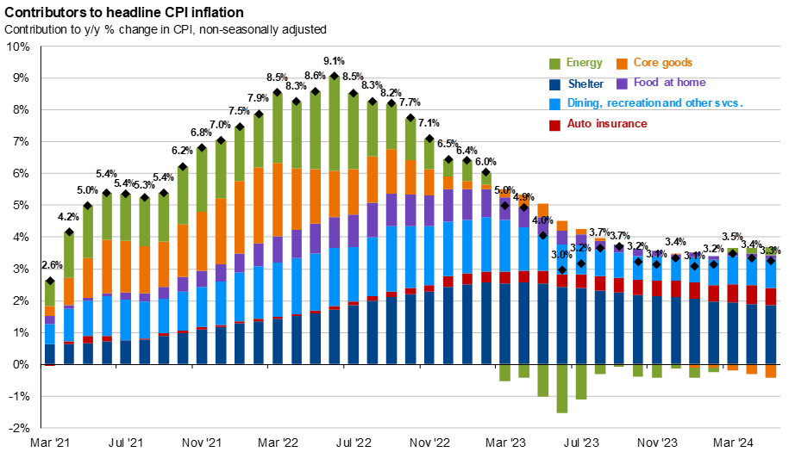
Source: BLS, FactSet, J.P. Morgan Asset Management. Contributions mirror the BLS methodology on Table 7 of the CPI report. Values may not sum to headline CPI figures due to rounding and underlying calculations. “Shelter” includes owners’ equivalent rent, rent of primary residence and home insurance. Guide to the Markets – U.S. Data are as of June 30, 2024.
Notes:
This chart shows inflation for various categories of goods and services.
If you look back at 2022 when we hit 9% year over year inflation, all components were contributing to high inflation.
Fast forward to June 2024, and inflation is primarily concentrated in shelter, dining & recreation, and auto insurance.

Slide 5
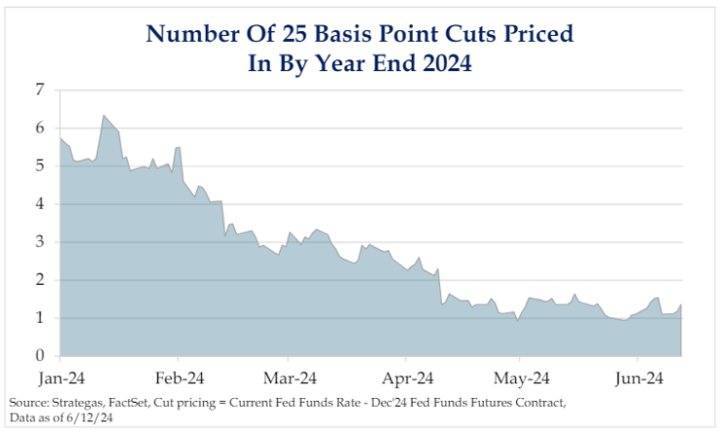
Fewer rates cuts than previously expected
Notes:
As the chart shows, there were roughly six Fed rate cuts expected for 2024 at the start of the year, down to three at the end of the first quarter, and only one cut is now expected before the end of the year. Why the changes? Well, with a Fed that openly states they are data dependent, inflation still above-target, and solid growth continuing, they are in no hurry to reduce rates prematurely. This is another example of why we don’t try to time the markets….

Slide 6
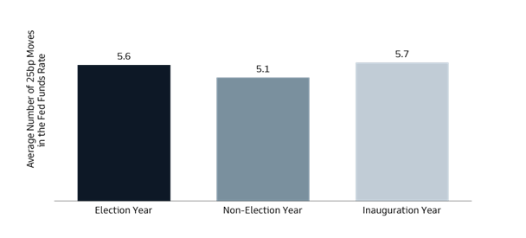
Will the Fed adjust rates
in an election year?
Source: St. Louis Fed and Goldman Sachs Asset Management, as of June 28, 2024
Notes:
Fed Chairman Powell continued to state the Fed is going to be data dependent in deciding if and when to lower rates. And as we approach November (you may have heard there are elections in November), some investors may ask if the Fed would make any rate cuts before the election. The simple answer is yes, they may, as they have in the past. Last quarter we showed a chart highlighting the path of Fed rate cuts and increases, along with how they intersected with election years. This quarter we are giving you the data. As the chart shows, the Fed has made six 25-basis point adjustments, on average, during election years, similar to during inauguration years, and slightly higher vs. non-election years, highlighting the Fed being apolitical, or at least agnostic to the election cycle.
Is the Fed supposed to be apolitical? Yes! It is also important to remember that while the Federal Reserve Chairman is nominated by the President, the Federal Reserve is not part of the Federal Government and is not directed to act based on the President’s wishes. In other words, the Fed is expected to remain independent of politics.

Slide 7
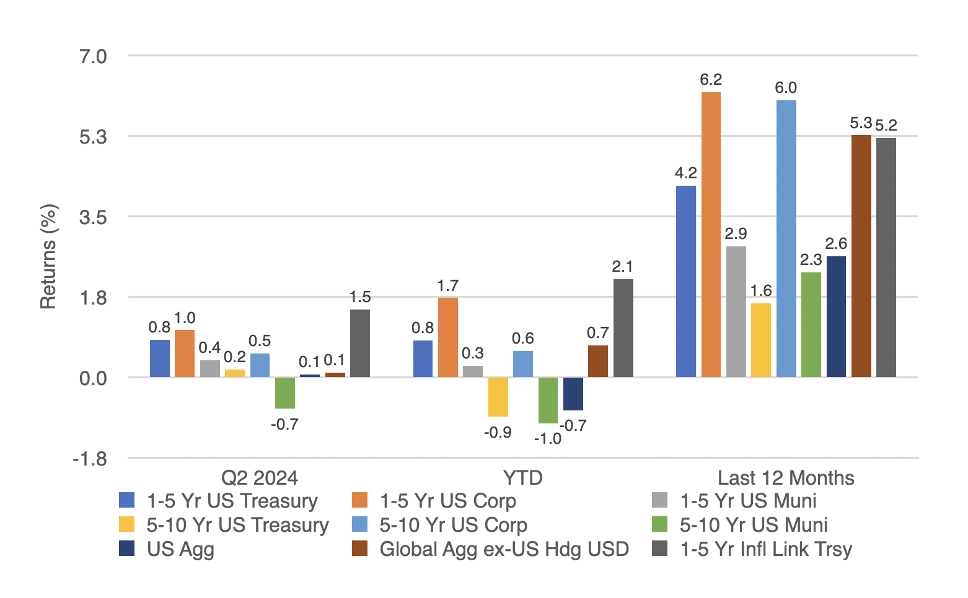
Global
Bond Returns
Source: Morningstar, Bloomberg and ICE BofA ML benchmarks shown. Past performance is not indicative of future results.
Notes:
Bond returns were mainly positive for the second quarter with the exception of 5-10 yr munis, which fell -0.7%. Treasury rates rose slightly over much of the yield curve but due to current yields, the income was able to compensate for price depreciation from rising yields. Rates rose as inflation remains stubbornly high and the Fed signaled they are going to keep interest rates higher for longer. Treasury rates fell for a few days in June when the May CPI report was released (and suggested inflation was cooling) before rates crept back up to end the month. Corporates fared better vs. Treasuries over the time periods shown. Non-US bonds (hedged to the USD) continue to be a positive contributor, having returned 5.3% over the last 12 months.

Slide 8
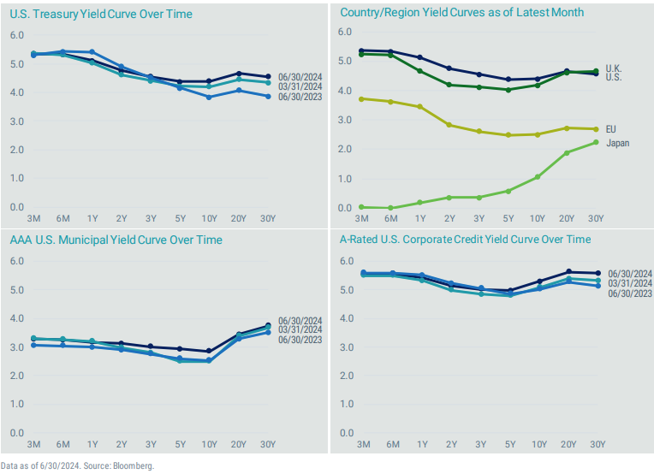
Stories from global yield curves
Notes:
This is a set of charts we often include because they offer several good stories to tell.
Rates rose slightly across most of the US Treasury curve (top left), so the yield curve is slightly less inverted than it was 3 months ago. The same can be said for the muni and corporate curves as well.
If you look at the chart on the top right, you can see how the various country curves are differently shaped and that they offer substantially different levels of rates, highlighting the diversification opportunities that exist by investing globally in bonds too.

Slide 9
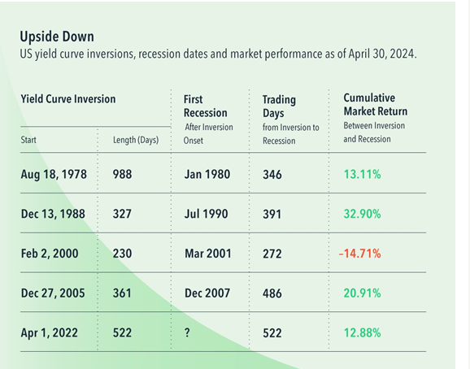
What does
an inverted yield curve tell us?
Source: Dimensional Funds, Past performance is not a guarantee of future results. Actual returns may be lower. Inversion when the yield on the 2-year Treasury exceeded the yield on the 10-year Treasury. Recession dates represent the peak month of the business cycle. Individual inversion onset defined as those lasting at least 50 trading days with no inversion in the prior 250 trading days. Number of days and return since onset of current inversion are through April 30, 2024. 10-year and 2-year constant maturity Treasury yields from FactSet. Business cycle dates from NBER. Market return represented by the Fama/French Total US Market Research Index. The Fama/French indices represent academic concepts that may be used in portfolio construction and are not available for direct investment or for use as a benchmark. Eugene Fama and Ken French are members of the Board of Directors of the general partner of, and provide consulting services to, Dimensional Fund Advisors LP. See “Index Descriptions” for descriptions of the Fama/French index data.
Notes:
There are many rules of thumb in investing. Unfortunately, like other rules of thumb, many are based on perceived experiences rather than theory or reality, and therefore can be invalid. One rule of thumb we often hear is that an inverted yield curve is a sign that a recession is likely upcoming. As a reminder, an inverted yield curve is when short term interest rates are higher vs. long term rates and is considered unusual as investors should expect a higher level of return for longer-dated bond instruments.
Is this rule of thumb accurate? Well, the chart above shows several periods where there have been lengthy periods between a yield curve inversion and the next recession. Note in the bottom row that, not only has the predicted recession not occurred, but the equity market has been positive during this period as well, returning 12.9% through April 30, 2024. This debunks yet another misconception that stock market returns are correlated with economic growth.
This provides all the more reason we would not recommend investing simply based on rules of thumb.

Slide 10
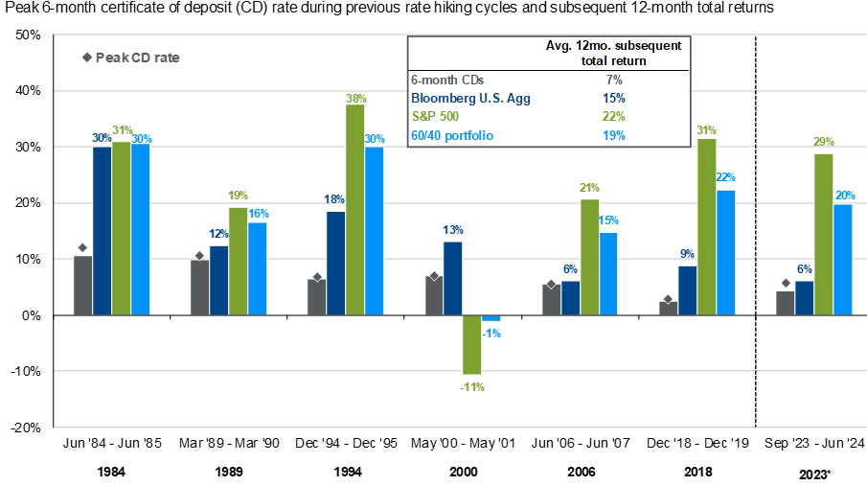
Don’t get caught in a “cash trap”
Source: Bloomberg, FactSet, Federal Reserve, Standard & Poor’s, J.P. Morgan Asset Management. The 60/40 portfolio is 60% invested in S&P 500 Total Return Index and 40% invested in Bloomberg U.S. Aggregate Total Return Index. The analysis references the month in which the month-end 6-month CD rate peaked during previous rate hiking cycles. CD rate data prior to 2013 are sourced from the Federal Reserve, whereas data from 2013 to 2023 are sourced from Bloomberg. CD subsequent 12-month return calculation assumes reinvestment at the prevailing 6-month rate when the initial CD matures. *Current period assumes that the month-end CD rate peaked on 9/30/2023. Returns for this period are calculated through 6/30/2024 and are not included in average calculations. Guide to the Markets – U.S. Data are as of June 30, 2024.
Notes:
With yields in money market funds and CDs hovering around 5%, it can be tempting for investors to sit in cash. The thinking is they will sit in cash until the Fed lowers rates, and then move to something else, such as other types of bonds or even stocks. We would argue that while the cash yield is attractive today, it won’t always be this way, and if you wait until the Fed lowers rates, you will likely have missed a golden opportunity. Sitting in cash too long is referred to as the cash trap. Remember, the market will move ahead of the Fed’s decision. In addition, as this slide shows, even though the peak CD rate has been attractive in most of the previous rate hiking cycles, bonds and stocks have generated much stronger returns vs. 6-month CDs in the 12 months following the peak CD rates.

Slide 11
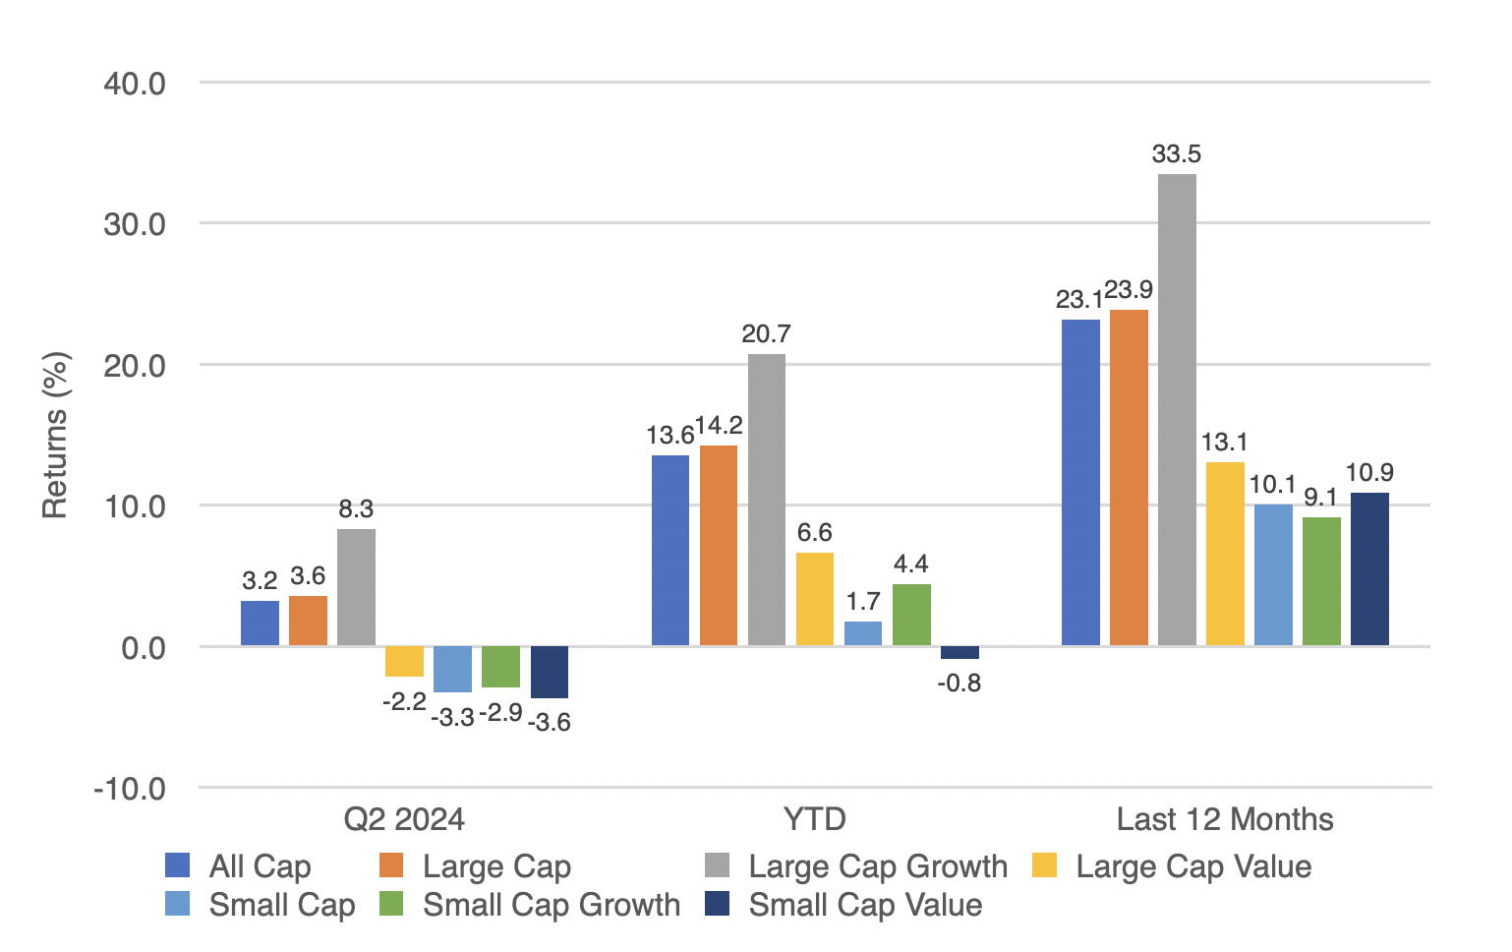
US stock returns by size and style
Source: Morningstar, Russell benchmarks shown. Past performance is not indicative of future results.
Notes:
US stocks were mixed for the quarter, most are up YTD and all have 9% or higher returns over the last 12 months.
It is important for clients to recognize how strong these 1 yr returns are. Specifically, on a historical basis, the average annual return for the S&P hovers around 10% so some asset classes are already well over this in just the first 6 months of the year. Of course we have no way to know if that will continue.
In future slides, we will talk about where the returns for large cap growth have been coming from, as well as any concentration risk that may result.

Slide 12
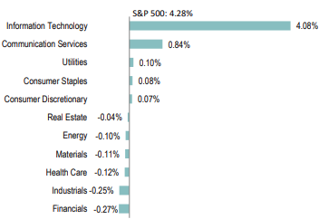
The tech sector dominated the S&P in Q2
Source: https://www.spglobal.com/spdji/en/documents/performance-reports/dashboard-us.pdf. Past performance is not indicative of future results.
Notes:
For the second quarter, the S&P 500 returned 4.3% Amazingly, the tech sector as a whole was responsible for 4.08% of the 4.28% return. In fact, tech was the only sector that contributed more than 1% to return, with 6 of the 11 sectors having negative returns for the quarter.

Slide 13
The
Magnificent 7: 2023 vs. 2024
Company | Ticker | 2023 Return | Q1 2024 Return | Q2 2024 Return
Apple | AAPL | 48.9% | -10.8% | 23.0%
Microsoft | MSFT | 58.0% | 12.1% | 6.4%
Alphabet (Google) | GOOGL | 58.3% | 8.1% | 20.8%
Amazon | AMZN | 80.9% | 18.7% | 7.1%
NVIDIA | NVDA | 239.0% | 82.5% | 36.7%
Meta | META | 194.1% | 37.3% | 3.9%
Tesla | TSLA | 101.7% | -29.3% | 12.6%
Source: Morningstar, Factset, Standard and Poors, JP Morgan Asset Management. Past performance is no guarantee of future results.
Notes:
We know the S&P 500 had a strong start to 2024. We also know the vast majority of that return (61%) came from just 7 stocks, known as the Magnificent 7, as they have returned 33% YTD through June while the rest of the S&P returned only 5%.
The average person thinks it should have been obvious that these magnificent seven stocks were going to outperform in 2023 and 2024. But was it? If you look at 2022, those same 7 stocks did a lot worse vs. the rest of the S&P 500. Many investors would have had a different attitude about these stocks coming off of a year like that.
Will their dominance continue? See the next page for more.

Slide 14
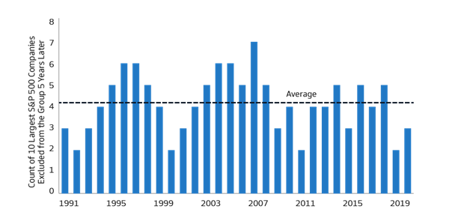
Should I just buy the Magnificent 7?
Source: Bloomberg and Goldman Sachs Asset Management. As of March 31, 2024. Past performance is not indicative of future results.
Notes:
Based on the success of the Mag 7 in 2023 and 2024, some investors may be tempted to significantly overweight those stocks, thinking they will continue to dominate.
However, if history is our guide, this chart shows that since 1990, roughly 4 of the top 10 S&P stocks by market capitalization fell out of the group in the following 5 years, on average. In other words, we would recommend diversifying into other stocks as well.
In fact, if you look at the S&P 500 top 10 holdings from five years ago vs. today, there are 3 stocks that were in the top 10 (Johnson and Johnson, JP Morgan, and Exxon Mobil) that are no longer included and were replaced by Nvidia, Eli Lilly, and Broadcom.
And if you go back 10 yrs, to July 1, 2014, only 3 of the S&P 500 holdings from that time (Microsoft, Apple, and Berkshire Hathaway) are still in the top 10 now. The other seven stocks that were previously included (Exxon Mobil, Johnson and Johnson, GE, Wells Fargo, Chevron, JP Morgan, and Proctor & Gamble) have all fallen out.
Note: The review of holdings from five and ten years ago was performed using Morningstar Direct, using SPY as a proxy for the index; SPY is an ETF that tracks the S&P 500, with recent holdings available (June 27, 2024)

Slide 15
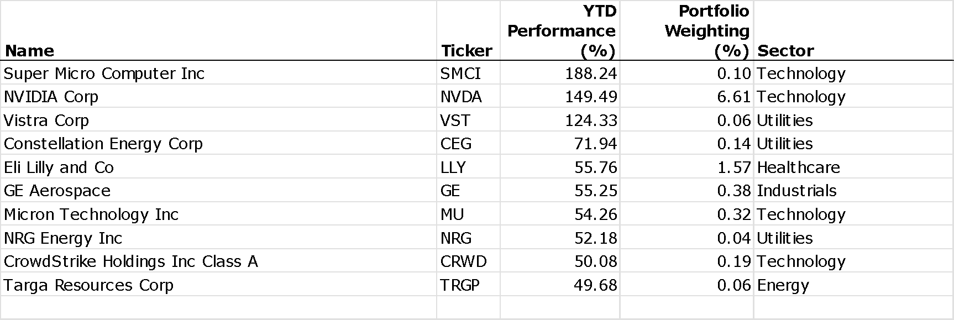
Are only tech stocks doing well in the US?
Source: Morningstar Direct, SPY was used as the ticker to represent the S&P 500, data as of June 27, 2024. Past performance is not indicative of future results.
Notes:
Because of the stellar performance of Nvidia and the strong returns of the Mag 7 that we have already discussed, it might lead investors to think that only tech companies are doing well. In fact, even with its 149% YTD return, Nvidia isn’t even the top performing S&P company over the time period. That goes to Super Micro Computer with its 188% return through the first 6 months. However, unlike Nvidia and its significant portfolio weighting, Super Micro Computer only has a weight of 0.1%, so it has much less influence on total index returns.
If you look across the top ten performing stocks in the S&P 500, there are 4 within tech with a total weight of 7.2% (Nvidia is 6.6% by itself). But there are three in the utilities sector, with a combined weight of just 0.2%. One is in healthcare (1.6% weight), one is in industrials (0.4% weight) and yet another in energy (0.1%). The moral of the story is that strong returns are able to be found beyond the tech sector.

Slide 16
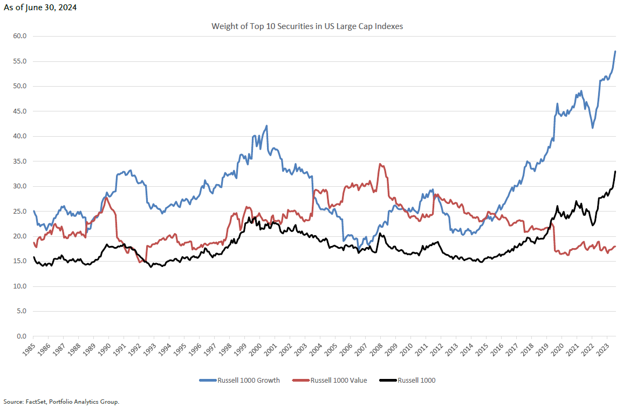
US large growth index is highly concentrated
Notes:
Earlier we talked about how the S&P was concentrated in its top 10 holdings (37% weighting).
Well, if we look at the R1000G index, it is even more concentrated with roughly 60% of the index weight coming from just 10 securities. This is well over the previous high (since 1985) of roughly 42% and significantly higher vs. the 20% concentration of just ten years ago. With more concentration, the index will be heavily influenced by just those ten stocks.
If we use the ishares Russell 1000 Growth ETF as a proxy (ticker IWF), the holdings at 6/30 are:
MSFT 12.4%
Apple 11.4%
Nvidia 10.9%
Amazon 6.67%
Meta 4.1%
Google A 4%
Google C 3.4%
Eli Lilly 2.9%
Broadcom 2.7%
Tesla 2.4%

Slide 17
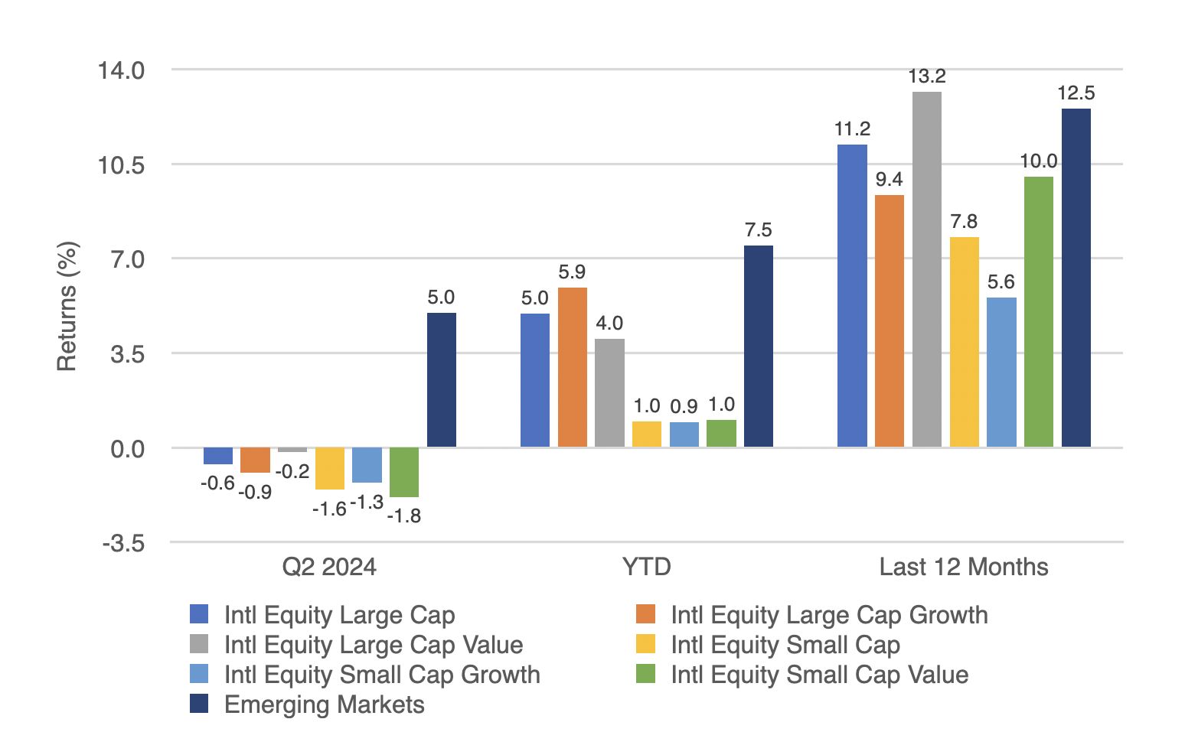
International developed and emerging market stock returns
Source: Morningstar, MSCI benchmark shown. Past performance is not indicative of future results.
Notes:
Outside the US, all developed markets index returns were negative for the quarter, with only emerging markets having a positive return (5%).
Some investors may look at these returns compared to their US counterparts and simply suggest that non-US companies simply can’t keep pace. However, this doesn’t appear to be the case. In upcoming slides, we will show that there are still strong companies outside the US.

Slide 18
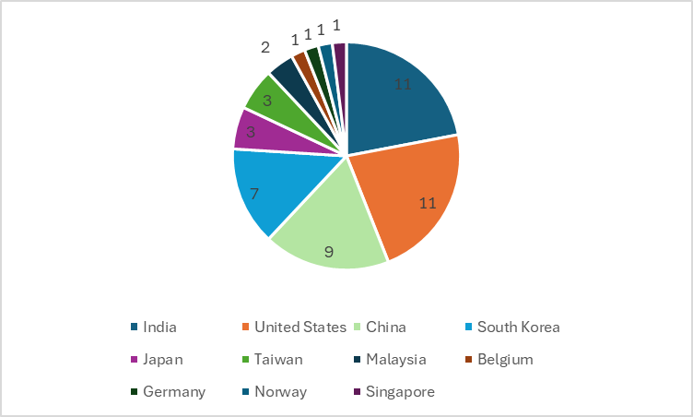
Does the US have a monopoly on the best performing stocks across the globe?
Source: Morningstar Direct, ACWI was the ETF used to replicate the MSCI ACWI, data as of June 13, 2024. Chart looks at the 50 companies with the highest YTD return. Past performance is not indicative of future results.
Notes:
The short answer to the question of whether the US has a monopoly on the best performing stocks is “no”.
Looking at the ETF with the ticker ACWI to replicate the MSCI ACWI, a benchmark used to show global stocks, we can see that of the top 50 companies with the highest YTD return, there are 11 from the US, which means there are 39 from other countries including 11 from India, 9 from China, and 6 from South Korea.

Slide 19
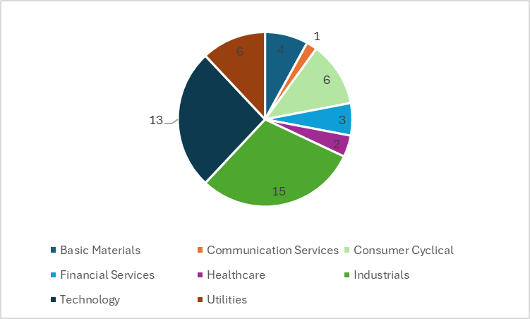
Does the tech sector have a monopoly on the best performing stocks across the globe?
Source: Morningstar Direct, ACWI was the ETF used to replicate the MSCI ACWI, data as of June 13, 2024. Chart looks at the 50 companies with the highest YTD return. Past performance is not indicative of future results.
Notes:
The short answer to the question of whether the tech sector has a monopoly on the best performing stocks across the globe is also “no”.
Looking at the ETF with the ticker ACWI to replicate the MSCI ACWI, a benchmark used to show global stocks, we can see that of the top 50 companies with the highest YTD return, there are 13 in the tech sector, but there are 15 in industrials, another 6 in consumer cyclicals and 6 more from the utilities sector.

Slide 20
Dollar strength is good for US consumers but bad for owners of non-US investments
Source: Wall Street Journal as July 1, 2024. Past performance is not indicative of future results.
Notes:
WSJ’s Dollar Index (BUXX) represents the value of the USD relative to a basket of 16 foreign currencies.
A rising dollar is generally good for US consumers as it makes foreign goods cheaper to purchase, but bad for owners of non-dollar-denominated assets, such as foreign stocks. Said differently, a strong dollar hurts international returns. A strong dollar also hurts US exports and therefore can also negatively impact US production and employment.
The top chart shows the movement over the last 20 years for longer term trends while the bottom chart shows the last 3 months where the dollar rose. The top chart shows the dollar is currently still stronger than most other time since the inception of this WSJ Dollar Index. A continued US Dollar decline would be a tailwind for non-US equity returns vs. US equities.
For YTD 2024, the USD has clearly strengthened relative to other currencies broadly, though it has had its ups and downs. The likely main reason for this is the expectation the Fed will keep interest rates higher for longer, increasing the appetite for US investments, which serves to increase the USD relatively.

Slide 21
Maintain your focus on what really matters
Financial planning is a process, not an endpoint
Concentrate on long-term goals and objectives
Focus on reaching goals, not on beating benchmarks
Maintain a disciplined approach, in good and bad markets
Invest broadly and globally; asset allocation is key
Reduce investment and tax costs where possible
Rebalance as necessary

Slide 22
Questions?

Slide 23
Disclosures
This information is not intended to be used as the primary basis for investment decisions, nor should it be construed as advice designed to meet the particular needs of an individual investor. Investing in mutual funds, ETFs, and other equity and debt securities involves risk, including loss of principal. An investor should consider a portfolio’s investment objectives, risks, and expenses carefully before investing. Please read any applicable funds’ prospectus carefully before investing. Investors cannot invest directly in an index. Indexes are unmanaged and reflect reinvested dividends and/or distributions, but do not reflect sales charges, commissions, expenses or taxes.
XYPN Invest constructs and manages investment models (“Model Portfolios”) through a technology solution. The Model Portfolios can be used by investment adviser representatives (“IARs”) of XYPN Invest, an SEC registered investment adviser (“RIA”), as well as IARs of other unaffiliated RIAs (“iIARs”). iIARs are members of XYPN, but not affiliated with the XYPN Invest RIA. XYPN Invest manages its Model Portfolios on a discretionary basis primarily by allocating assets among various mutual funds and exchange-traded funds (“ETFs”). XYPN Invest may allocate to individual securities in certain circumstances. IARs and iIARs are ultimately responsible for choosing the appropriate Model and overall allocations for their Clients.

