Slide 1
Monthly Office Hours July 9th, 2025

Slide 2
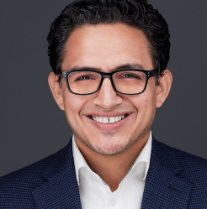
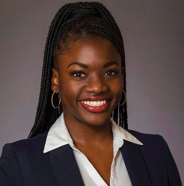
Presenters
Andrew Almeida, CFA, CFP
Director of Investment Services
Loyanne Wands, MBA
Client Service Manager
Market Updates
Operations Updates

Slide 3
Market Update with Andrew
Index Performance
Update on Market consensus
Currency
Equity
Fixed Income

Slide 4
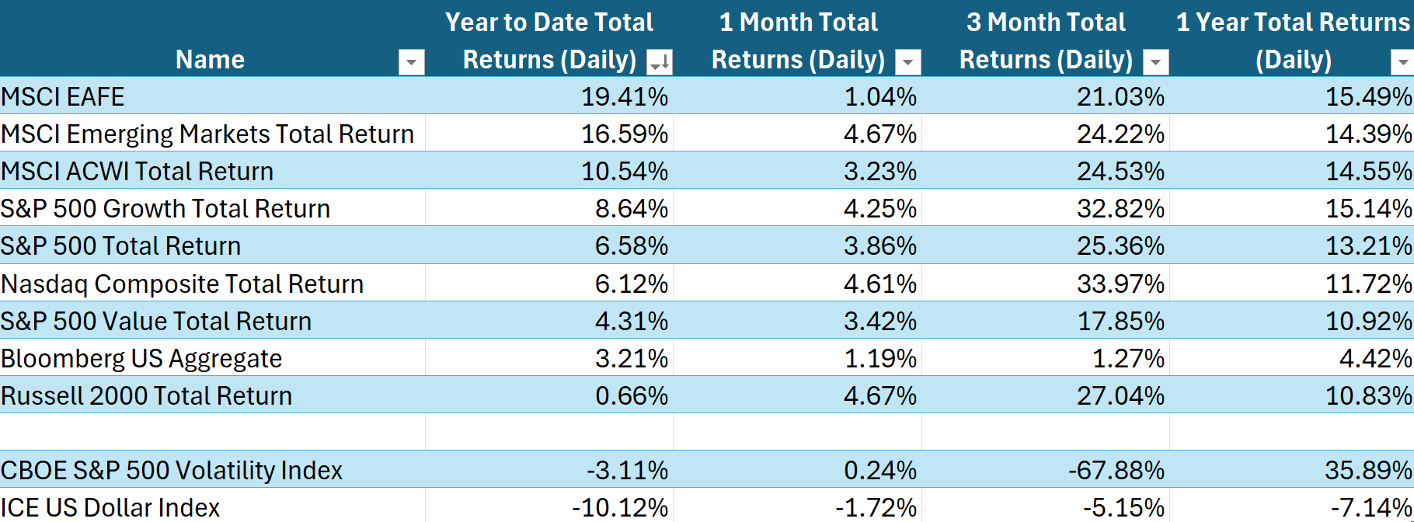
Index Performance

Slide 5
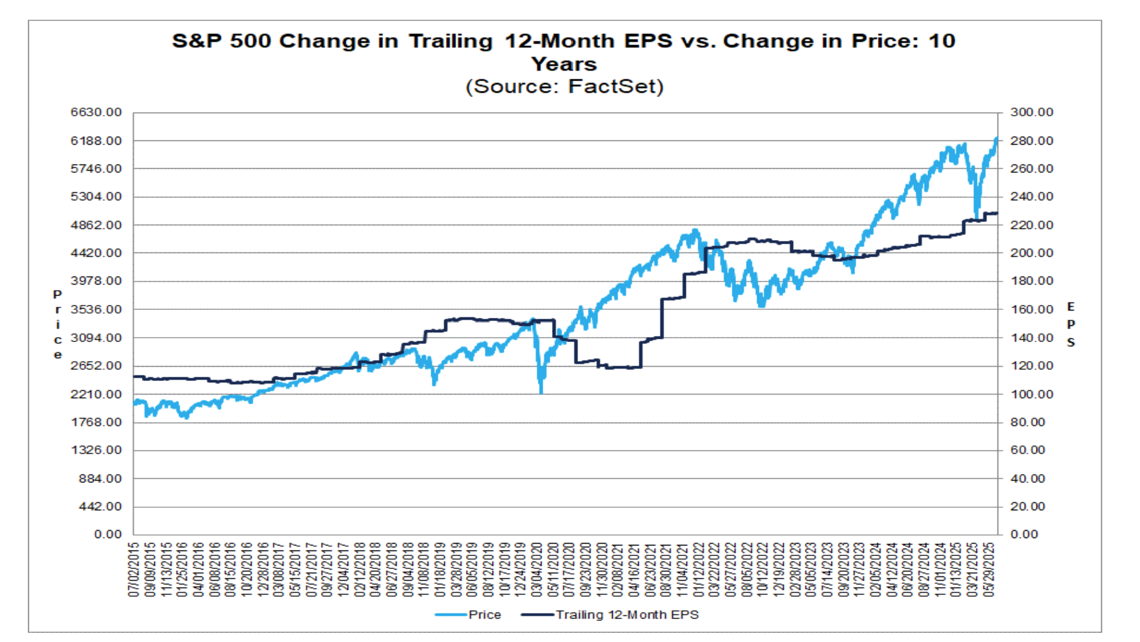
Equity Market Price and Earnings
Equity price performance is highly correlated to earnings growth
Periods where price outpaces earnings results in PE expansion

Slide 6
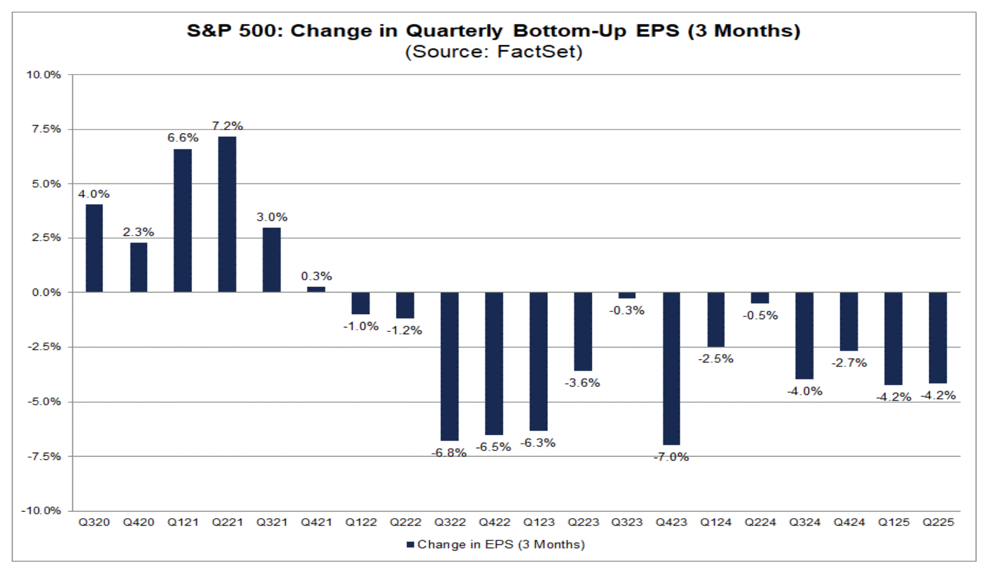
Estimates are being lowered
Q2 Expectation 9.2%
Q2 Actual 5%
While earnings are positive, they are not meeting growth expectations.
Analyst recognizing record amount of downward estimates

Slide 7
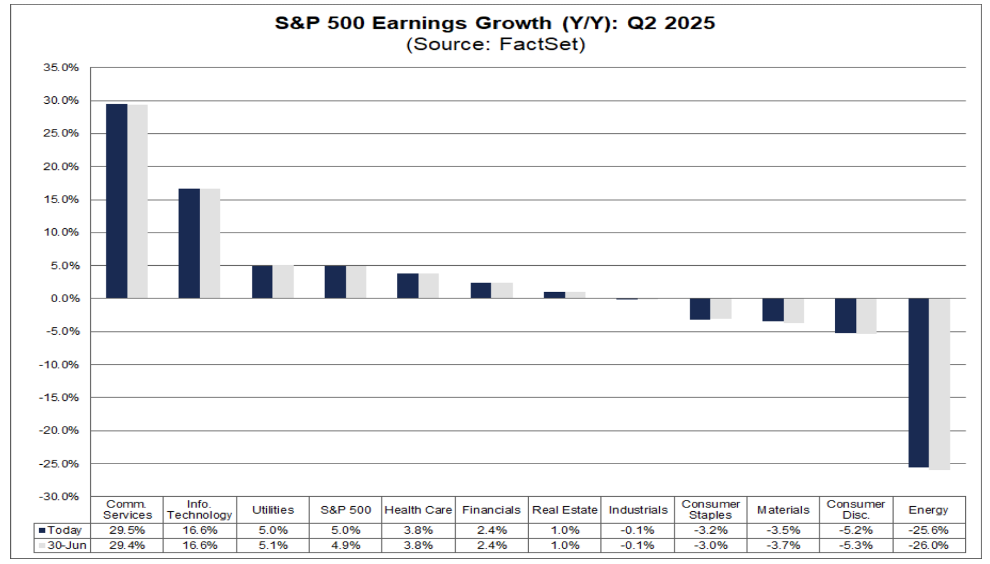
Resilient Earnings are Sector Specific
US Com Srvs, & IT carrying the weight
Make up combined 31% of US Market Cap
Changing economy reflecting by changes in CapEx - Think Ai

Slide 8
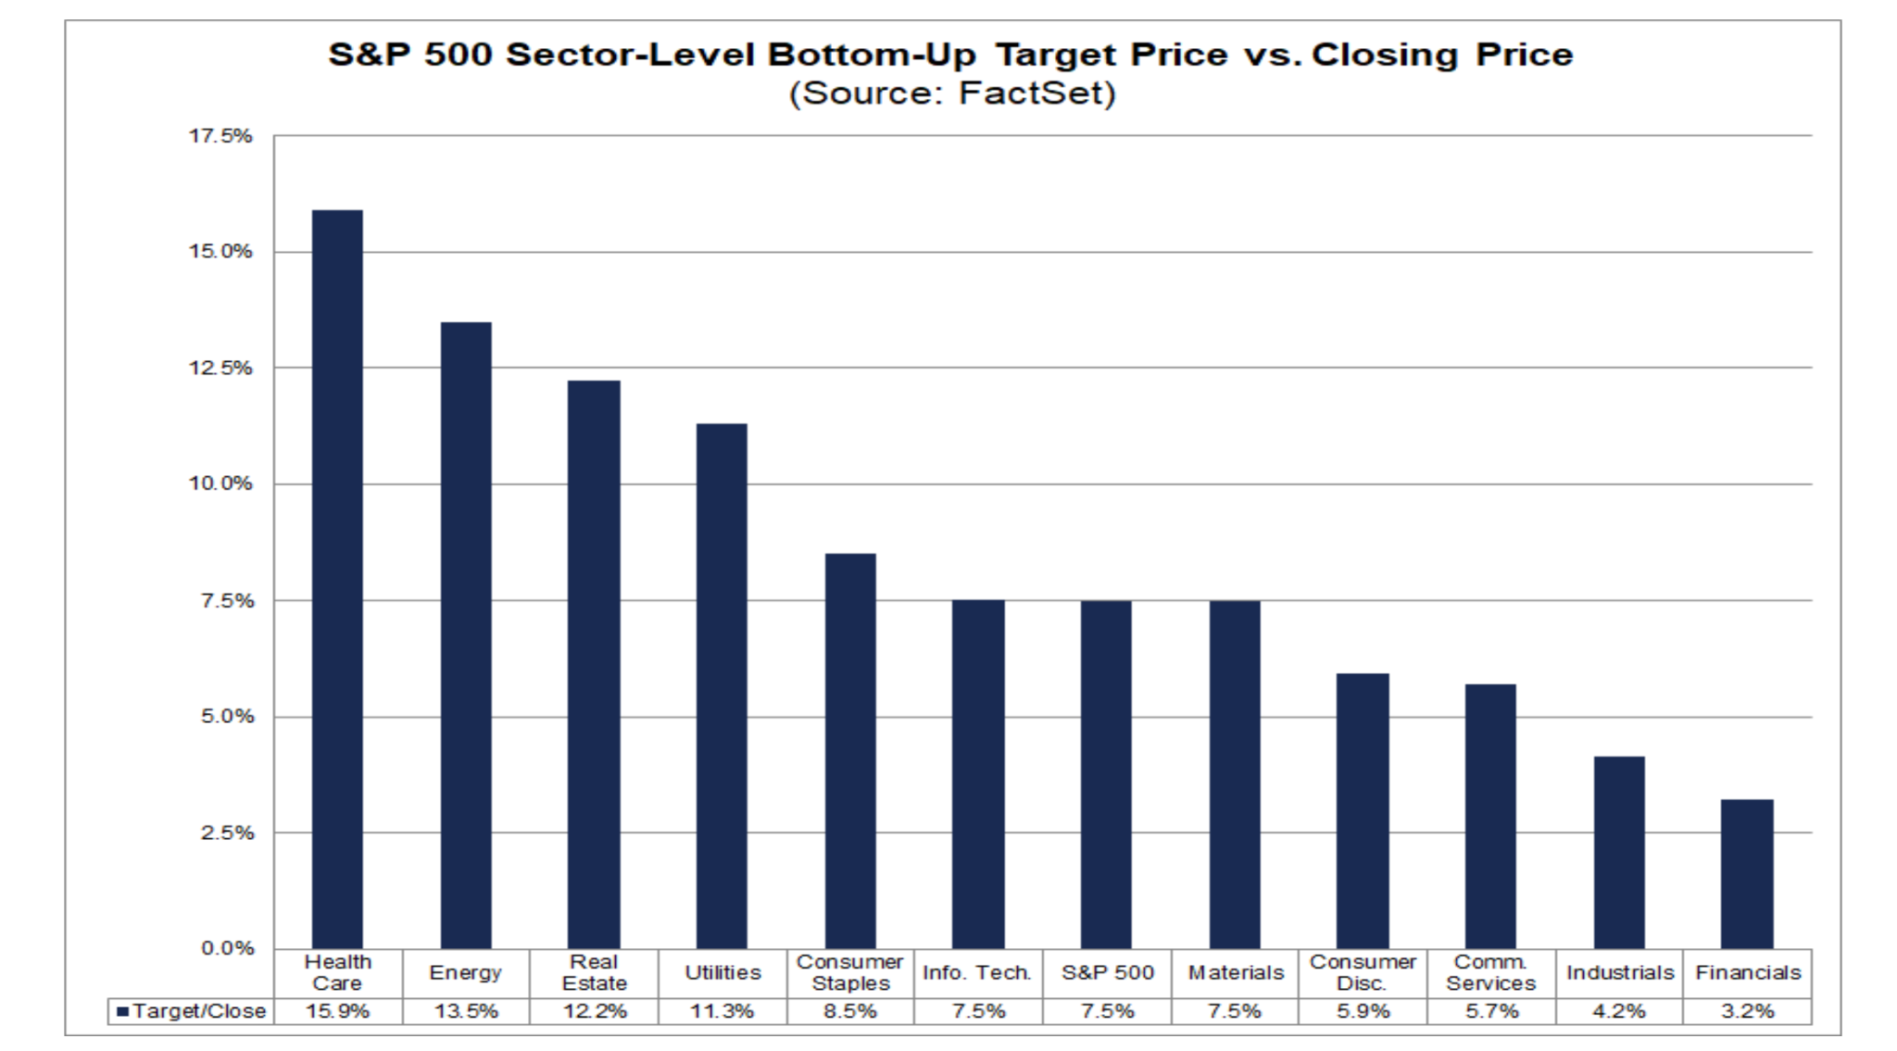
Street Still Positive on 1YR Expectations

Slide 9
US Yield Curve

Slide 10
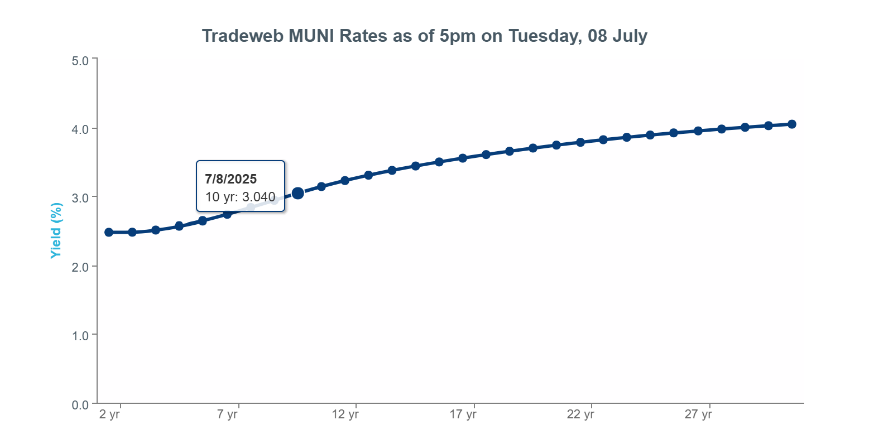
Municipal Markets Healthy

Slide 11
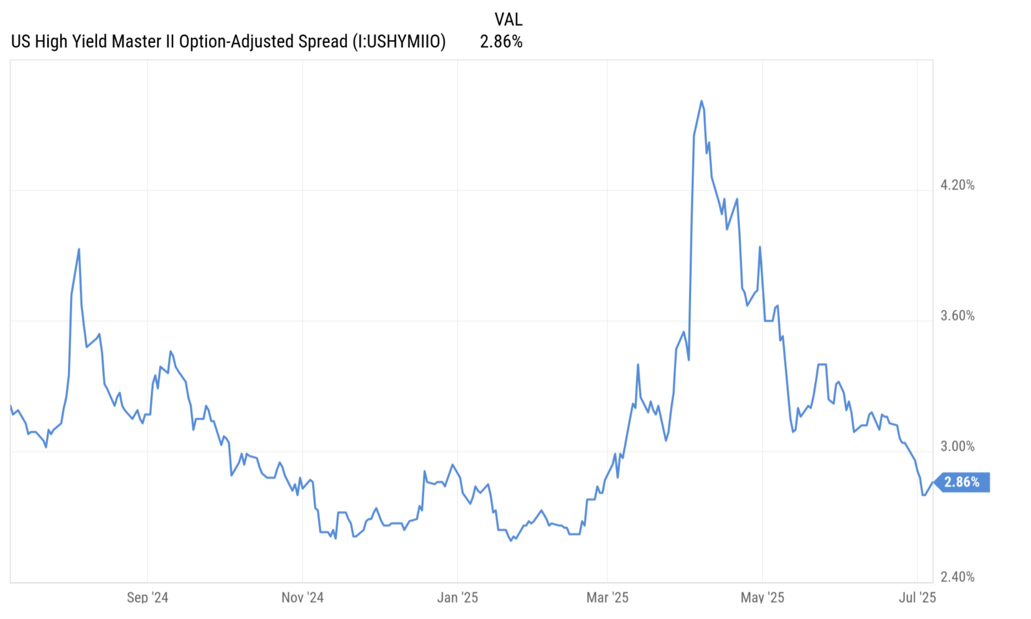
High Yield Signaling Confidence

Slide 12
Summary
Currency Market - Pricing US uncertainty
Equity Market - resilient in earnings, resilient in pricing, (likely pricing a rate cut before year end).
Could the equity market be wrong?
Fixed Income - not pricing in domestic uncertainty on long end. Not pricing long term inflation. Improved corporate credit outlook.
Uncertainty in tariff policy limits Powell

Slide 13
Operations update with Loyanne

Slide 14
Upcoming Changes to Office Hours
Starting in August, we will move away from Office Hours and have and Monthly Market Update with XYPN Invest.
We will continue provide operational updates to TAMP advisors, so we are launching a TAMP monthly newsletter.

Slide 15
New Account Submission
Use this form after you submit new account applications via Schwab's Digital Workflow (DWF) so we have all necessary information to follow up on the status and provide you with updates along the way.

Slide 16
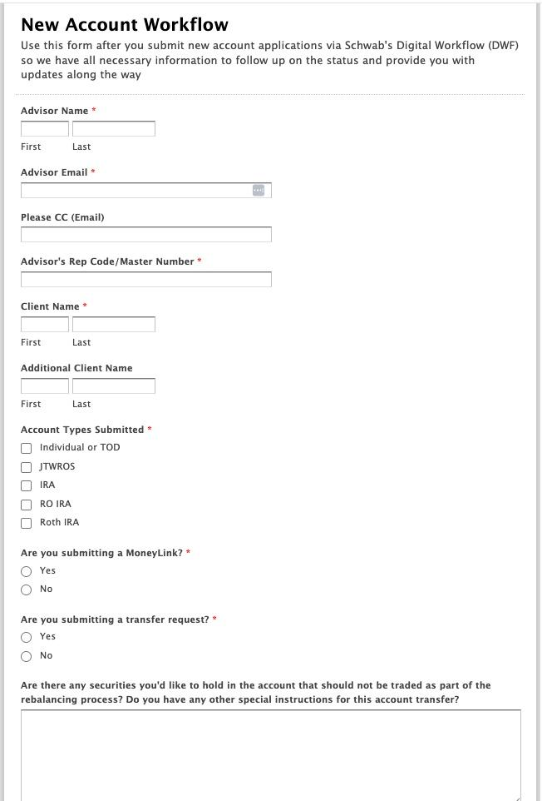

Slide 17
Growth Award Winner
Our growth award winner is Brent Hoskins, CFP®, founder of Focal Point Financial Group in Prairie Village, Kansas. Brent had the highest Net New Assets in June. Congratulations Brent!

Slide 18
Important Dates
Quarterly Market Review with Mario Nardone
July 15th, 2025 | 9 AM Pacific / 12 PM Eastern (Register HERE)
1
XYPN LIVE
Sept 25th-28th, 2025 | Austin Marriott Downtown / Austin,TX
Online Event Location: Learn more here!
2

Slide 19
Questions?
Reach our team via email: support@xyinvestmentsolutions.com

Slide 20
Disclosures
This information is not intended to be used as the primary basis for investment decisions, nor should it be construed as advice designed to meet the particular needs of an individual investor. Investing in mutual funds, ETFs, and other equity and debt securities involves risk, including loss of principal. An investor should consider a portfolio’s investment objectives, risks, and expenses carefully before investing. Please read any applicable funds’ prospectus carefully before investing. Investors cannot invest directly in an index. Indexes are unmanaged and reflect reinvested dividends and/or distributions, but do not reflect sales charges, commissions, expenses or taxes.
XYPN Invest constructs and manages investment models (“Model Portfolios”) through a technology solution. The Model Portfolios can be used by investment adviser representatives (“IARs”) of XYPN Invest, an SEC registered investment adviser (“RIA”), as well as IARs of other unaffiliated RIAs (“iIARs”). iIARs are members of XYPN, but not affiliated with the XYPN Invest RIA. XYPN Invest manages its Model Portfolios on a discretionary basis primarily by allocating assets among various mutual funds and exchange-traded funds (“ETFs”). XYPN Invest may allocate to individual securities in certain circumstances. IARs and iIARs are ultimately responsible for choosing the appropriate Model and overall allocations for their Clients.

