Slide 1
Monthly Office Hours June 11th, 2025

Slide 2
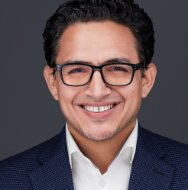
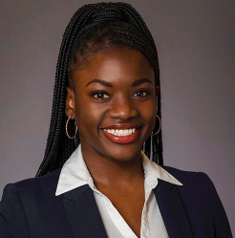
Presenters
Andrew Almeida, CFA, CFP
Director of Investment Services
Loyanne Wands, MBA
Client Service Manager
Market Updates
Operations Updates

Slide 3
Market Update with Andrew
Indices
Model Update
Relative Value
Fixed Income/Northern Capital

Slide 4
Model Update
Tracker
Real Estate position will be updated from DFGR to REET

Slide 5
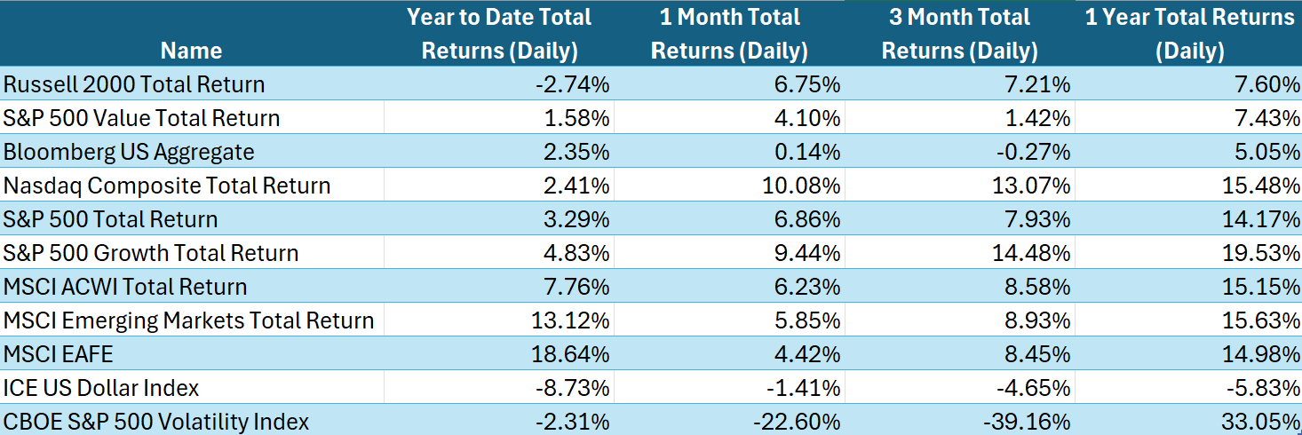
Performance Indices

Slide 6
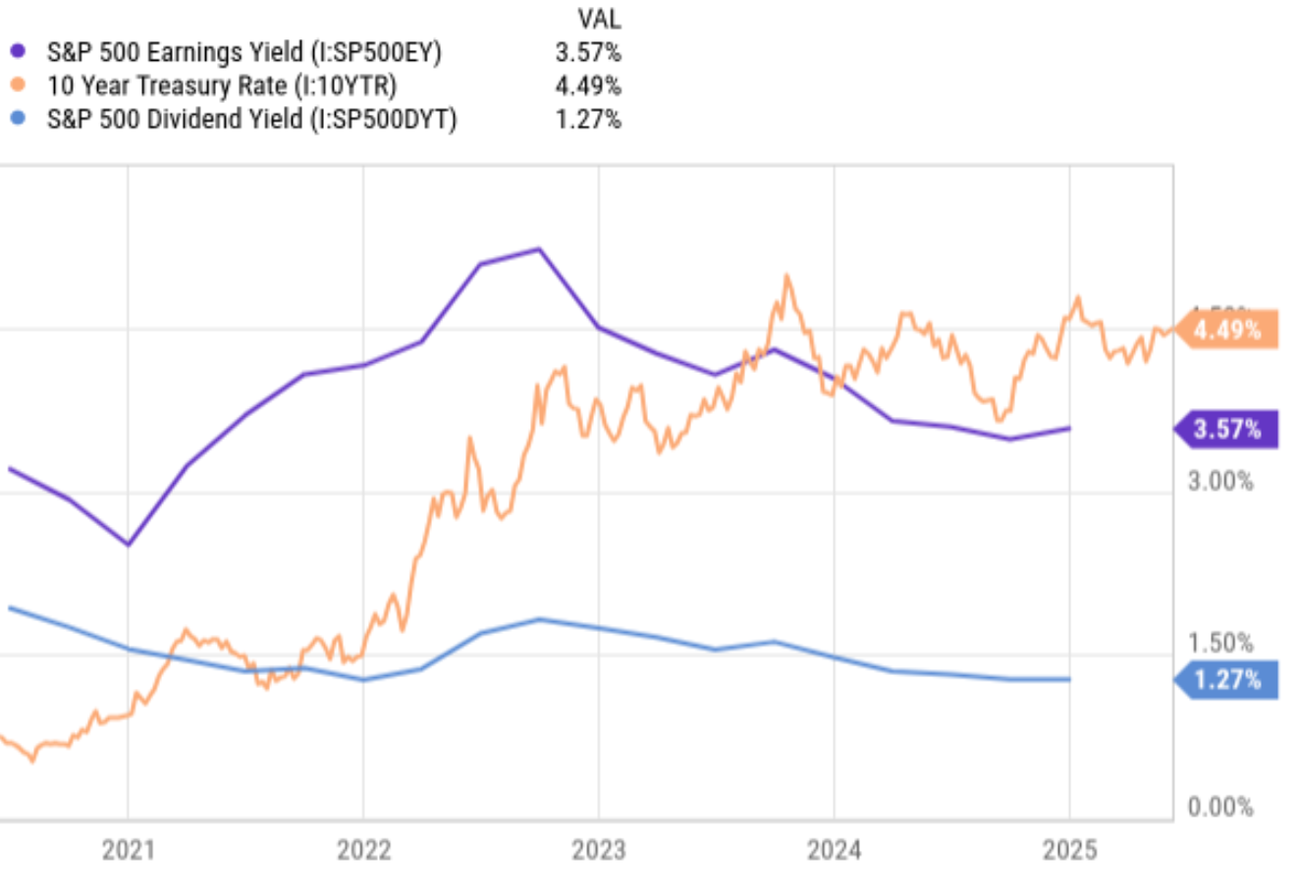
Relative Valuation
Q2 Earnings Growth of 4.9%
Compared to 9.3% last year
S&P PE = 28
SP Earnings Yield, 3.57%
US Treasury Yield 4.5%

Slide 7
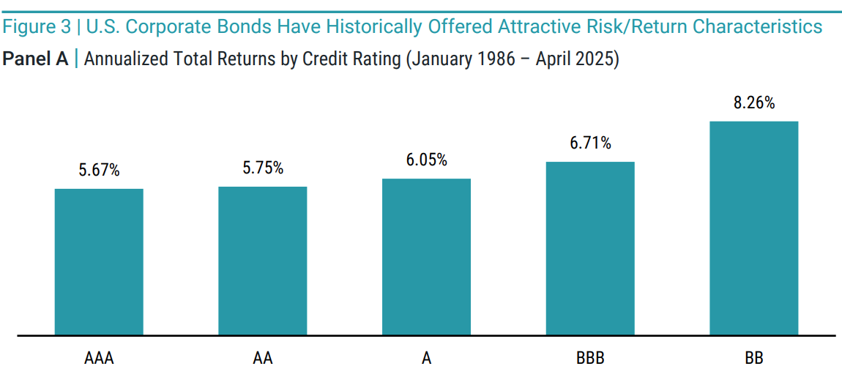
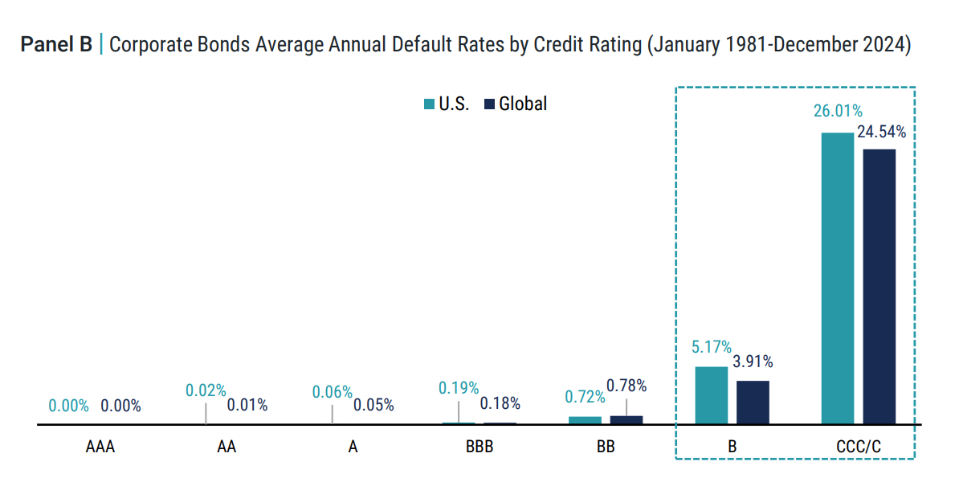
US Corporate Bonds

Slide 8
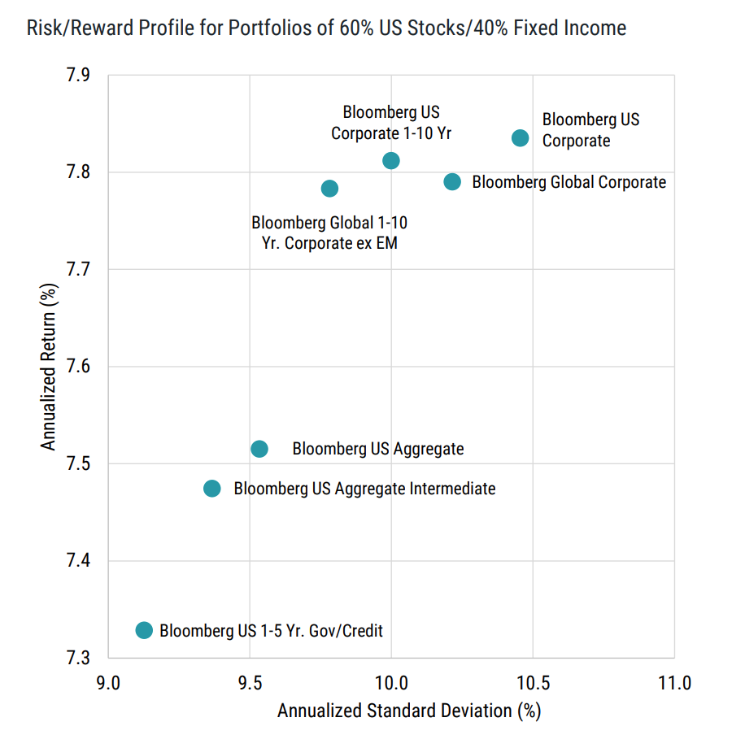
Global Bond Diversification
XY Core Fixed Income
Intermediate Corp Bond | VCIT | 30%
Intermediate Government | SPTI | 20%
World Bond - USD Hedged | BNDX | 30%
Short Term Corp Bond | VCSH | 10%
Inflation Protection | VTIP | 10%

Slide 9
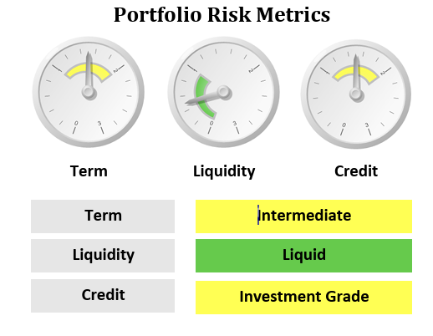
XYIS + Northern Capital
Individual Bond Portfolios
Munis and Corporates
Managed by XY Invest
Positioning and Research

Slide 10
Process
Model Assignment
https://support.xyinvestmentsolutions.com/article/162-model-assignment-trade-authorization
Email support@xyinvestmentsolutions.com and notify trade team for what account allocations you will use Individual Bonds

Slide 11
Operations update with Loyanne

Slide 12
REMINDER:
Digital Onboarding in Schwab Advisor Center
Onboarding clients is easier! Advisors can now open TAMP accounts using Schwab’s Digital Client Onboarding tool.

Slide 13
New Account Submission
Use this form after you submit new account applications via Schwab's Digital Workflow (DWF) so we have all necessary information to follow up on the status and provide you with updates along the way.

Slide 14
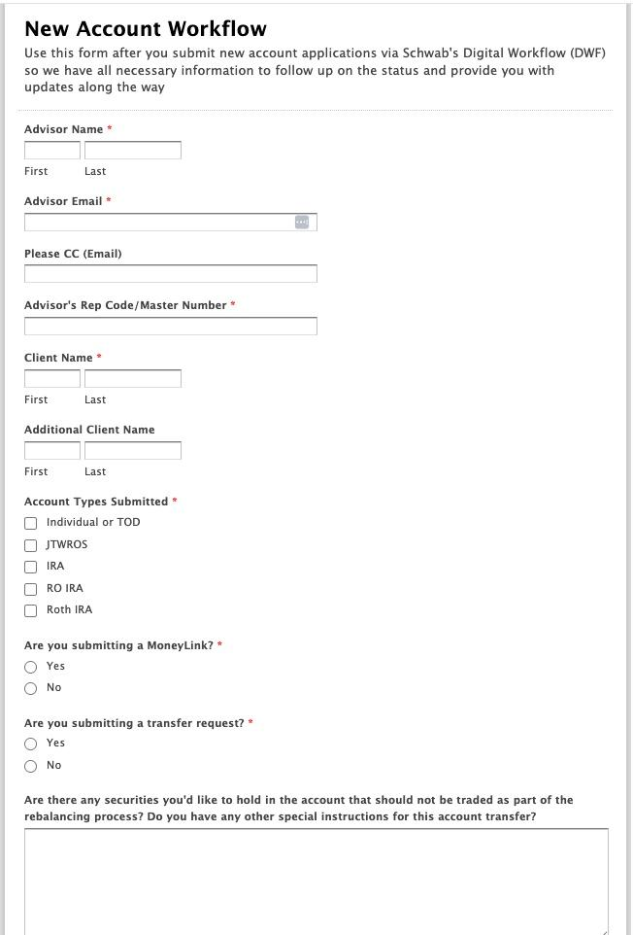

Slide 15
Growth Award Winner
Our growth award winner is Erik Goodge, CFP®, founder of uVest Advisory in Evansville, IN. Erik had the highest Net New Assets in May. Congratulations Erik!

Slide 16
Important Dates
Juneteenth - Office Closed
June 19th, 2025
1
Independence Day- Office Closed
July 4th, 2025
2

Slide 17
Questions?
Reach our team via email: support@xyinvestmentsolutions.com

Slide 18
Disclosures
This information is not intended to be used as the primary basis for investment decisions, nor should it be construed as advice designed to meet the particular needs of an individual investor. Investing in mutual funds, ETFs, and other equity and debt securities involves risk, including loss of principal. An investor should consider a portfolio’s investment objectives, risks, and expenses carefully before investing. Please read any applicable funds’ prospectus carefully before investing. Investors cannot invest directly in an index. Indexes are unmanaged and reflect reinvested dividends and/or distributions, but do not reflect sales charges, commissions, expenses or taxes.
XYPN Invest constructs and manages investment models (“Model Portfolios”) through a technology solution. The Model Portfolios can be used by investment adviser representatives (“IARs”) of XYPN Invest, an SEC registered investment adviser (“RIA”), as well as IARs of other unaffiliated RIAs (“iIARs”). iIARs are members of XYPN, but not affiliated with the XYPN Invest RIA. XYPN Invest manages its Model Portfolios on a discretionary basis primarily by allocating assets among various mutual funds and exchange-traded funds (“ETFs”). XYPN Invest may allocate to individual securities in certain circumstances. IARs and iIARs are ultimately responsible for choosing the appropriate Model and overall allocations for their Clients.

