Slide 1
Monthly Office Hours May 14th, 2025

Slide 2
Welcome to the Team!
Shana Bennett
Client Service Specialist
Allie Herd
Client Service Specialist

Slide 3
Market Update with Andrew
Account Review Process
Model Announcement
Market Update

Slide 4
Account Review Process
Review Allocations
Household Instructions
Cap Gains Budget
Do Not Sell
Tax Loss Harvesting
Cash Set Aside
Extending Time to 2 weeks

Slide 5
Model Update
Tracker - Now Fully Indexed
IC has decided to switch from DFGR (DFA Global REIT ETF) to
REET (iShares Global REET ETF)
Implementing Mid June

Slide 6
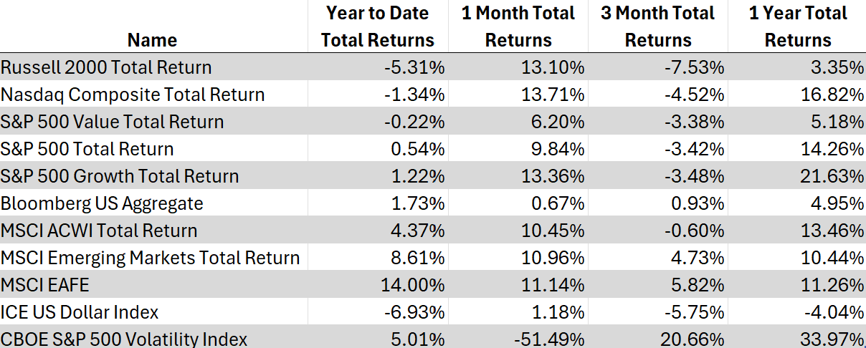
Indices

Slide 7
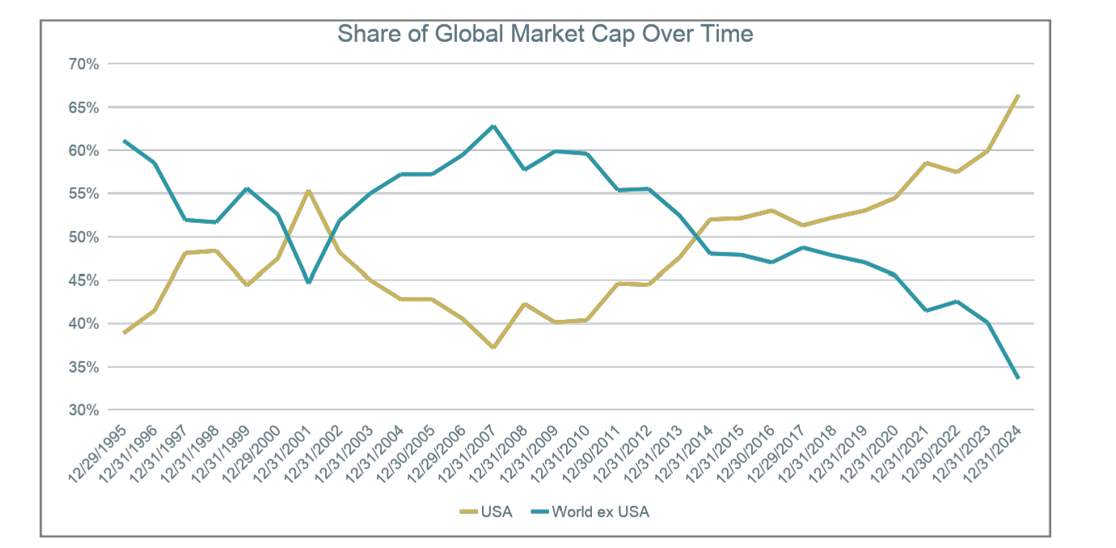
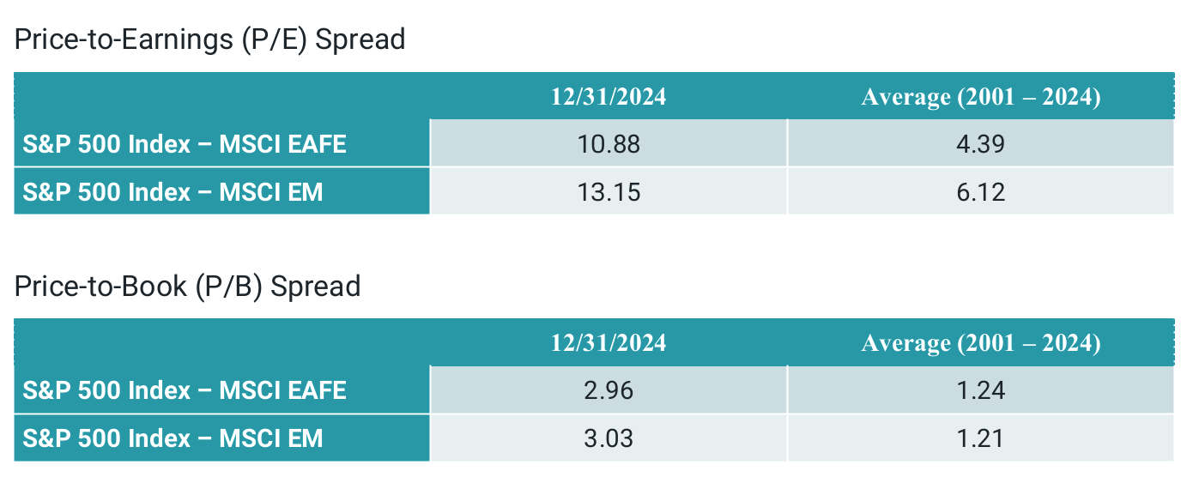
International
Benefits to International Diversification
Core and DFA Overweight to INT

Slide 8
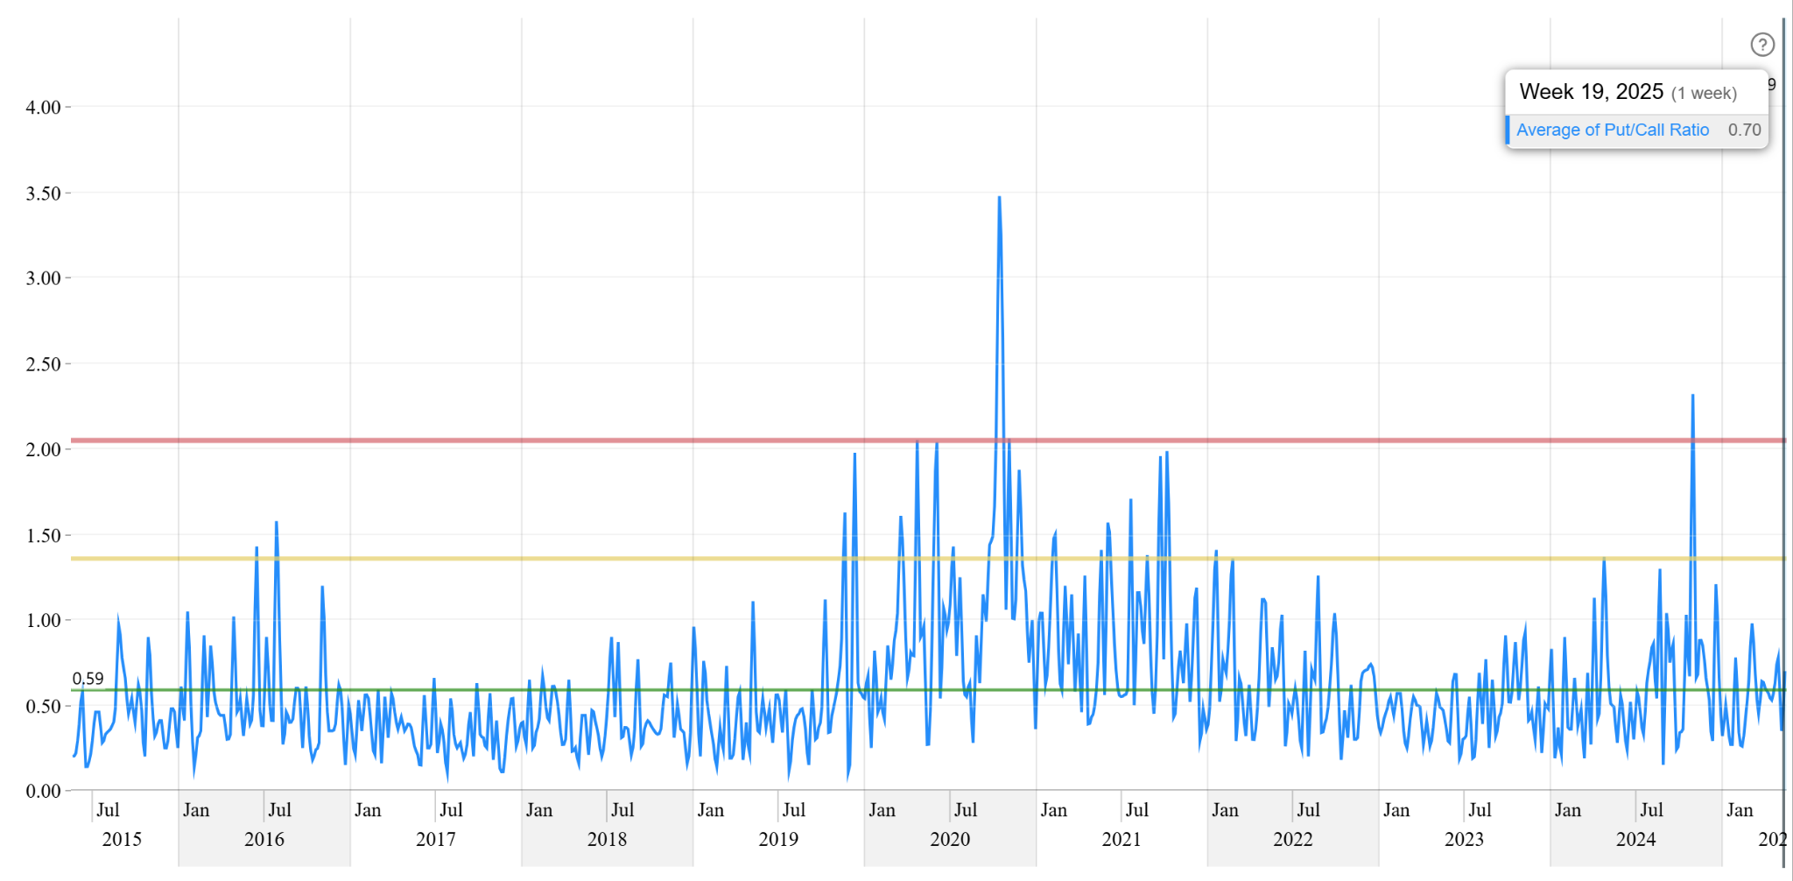
Volatility Pulse
S&P 500 P/C Ratio

Slide 9
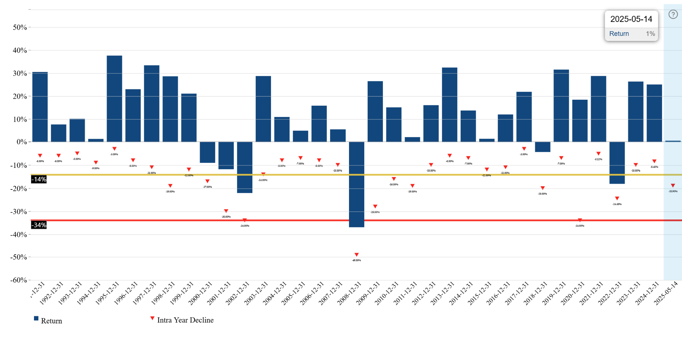
What is Normal Volatility?

Slide 10
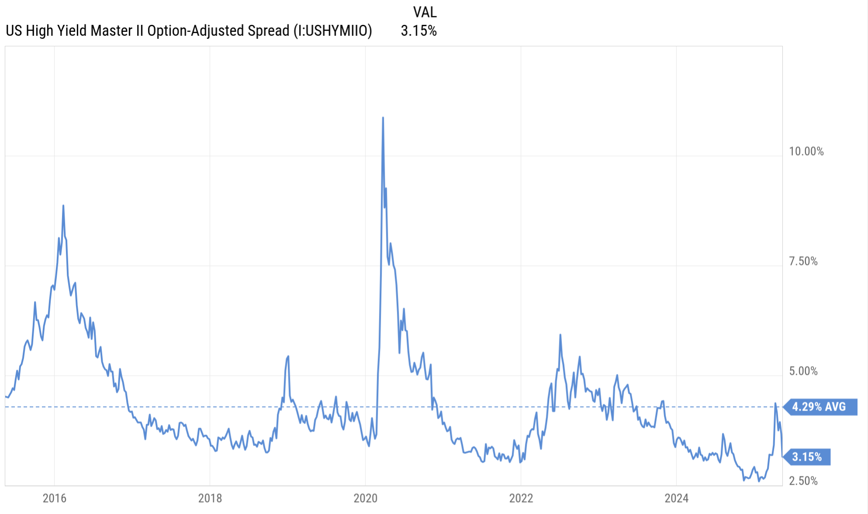
Credit Spreads - Check In

Slide 11
Operations update with Jena

Slide 12
Now Available:
Digital Onboarding in Schwab Advisor Center
Onboarding clients just got easier! Advisors can now open TAMP accounts using Schwab’s Digital Client Onboarding tool.

Slide 13
Pros & Cons
Import data from Wealthbox
Many accounts, one workflow
Validate transfers instantly
Super fast processing
Less NIGOs
Schwab Alliance Logins
Moneylink Limitations
Limited Registration Selection
No IPS tool

Slide 14
Wealthbox + Schwab
The integration between Wealthbox and Schwab Advisor Services™ allows users to send contact details from Wealthbox seamlessly into Schwab Advisor Center® to be imported into a Schwab Digital Account Envelope.
How to Enable the Integration
How to send data to Schwab

Slide 15
Use your TAMP Master!
When you arrive at the master account section, enter the master that was created for use with XY Investment Solutions as TAMP. You’ll know it’s right when you see “Affiliated TAMP for this account.” For reference, our master number is 0803-4273.
CLICK NO for “Are you assigning a money manager?” The TAMP is already being added via your TAMP master number.

Slide 16
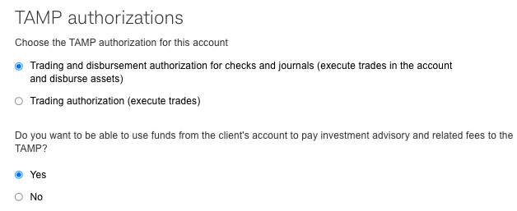
TAMP Authorization Requirements

Slide 17
Important Notice Regarding Moneylink
When adding Moneylink in the Digital Onboarding tool, the TAMP will not be given IA Authority. You will need to submit a separate service request to our team add the TAMP IA authority. Your client will receive a Docusign.
(Without this we cannot process Moneylink transactions on your behalf.)

Slide 18
Disclosure Delivery
Advisors are required to deliver this disclosure to clients who open accounts with XYPN Invest.
Please see the “Adding Firm Documents” section of the Digital Onboarding Guide to learn how to attach this disclosure to every Digital Onboarding! (You can also include your own disclosure!)

Slide 19
IPS Replacement
The proposal tool in Orion will no longer be available after May 30th, 2025. In its place, our investment team created a word template you can use in your practice. Some firms use their own templates or alternative proposal tools.
Click here for the template

Slide 20
What’s Next?
Additional Resources
Video Tutorials
Help Center Articles & FAQs
Updated request forms
Advisor Portal Sunset (5/30)
Digital Onboarding Guide
How to use Digital Onboarding
Weekly Schwab Webcast

Slide 21
Growth Award Winner
Our growth award winner is Brent Hoskins, CFP®, founder of Focal Point Financial Group in Kansas. Brent had the highest Net New Assets in April. Congrats!

Slide 22
Important Dates
Memorial Day - Office Closed
May 26th, 2025
1
Advisor Portal Sunset
May 30th, 2025
2
Juneteenth - Office Closed
June 19th, 2025
3

Slide 23
Questions?
Reach our team via email: support@xyinvestmentsolutions.com

Slide 24
Disclosures
This information is not intended to be used as the primary basis for investment decisions, nor should it be construed as advice designed to meet the particular needs of an individual investor. Investing in mutual funds, ETFs, and other equity and debt securities involves risk, including loss of principal. An investor should consider a portfolio’s investment objectives, risks, and expenses carefully before investing. Please read any applicable funds’ prospectus carefully before investing. Investors cannot invest directly in an index. Indexes are unmanaged and reflect reinvested dividends and/or distributions, but do not reflect sales charges, commissions, expenses or taxes.
XYPN Invest constructs and manages investment models (“Model Portfolios”) through a technology solution. The Model Portfolios can be used by investment adviser representatives (“IARs”) of XYPN Invest, an SEC registered investment adviser (“RIA”), as well as IARs of other unaffiliated RIAs (“iIARs”). iIARs are members of XYPN, but not affiliated with the XYPN Invest RIA. XYPN Invest manages its Model Portfolios on a discretionary basis primarily by allocating assets among various mutual funds and exchange-traded funds (“ETFs”). XYPN Invest may allocate to individual securities in certain circumstances. IARs and iIARs are ultimately responsible for choosing the appropriate Model and overall allocations for their Clients.

