Slide 1
Monthly Office Hours February 12, 2025

Slide 2
April 1, 2025
Model Change Summary
Core, All DFA, Kick Start, Cause, BRI
All model equity will shift towards approx. 60% US / 35% INTL / 5% REITs
1
Tracker: No Change
This model is intended to offer a more US-centric allocation, which remains at 70% of the equity total.
2

Slide 4
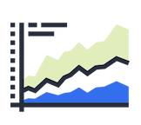
ETFs ONLY
MIN: $10,000
Fact Sheets & Performance
Core
CORE combines the low cost and tax efficiency of ETFs with factor tilts to small and value; and does so across a diversified list of managers. This represents our best thinking and is considered our preferred model.
 |  | Standard Model |  |  |  | Tax-Sensitive Model
Asset Class | Fund | Ticker | Alt. | Target |  | Ticker | Alt. | Target
Large Blend | Vanguard Total Stock Market | VTI | IWV | 36.0% |  | VTI | IWV | 36.0%
Small Value | DFA US Small Cap Value | DFSV | AVUV | 24.0% |  | DFSV | AVUV | 24.0%
Foreign Large Blend | Vanguard FTSE Developed Mkts | VEA | EFA | 16.0% |  | VEA | IEFA | 16.0%
Foreign Sm/Mid Value | Avantis International Small Cap Value | AVDV | DISV | 8.0% |  | AVDV | DISV | 8.0%
Emerging Markets | Avantis Emerging Markets Equity | AVEM | VWO | 11.0% |  | AVEM | VWO | 11.0%
Real Estate | DFA Global Real Estate | DFGR | REET | 5.0% |  | DFGR | REET | 5.0%
Corporate Bond | Vanguard Intermediate Corp | VCIT | SPAB | 30.0% |  | MUNI | MUB | 90.0%
Intermediate Government | SPDR Intermediate Treasury | SPTI | VGIT | 20.0%
World Bond - USD Hedged | Vanguard Total International Bond | BNDX | IAGG | 30.0%
Short Term Bond | Vanguard ST Corporate Bond | VCSH | IGSB | 10.0%
Inflation Protection | Vanguard ST Inflation Protection | VTIP | STIP | 10.0% |  | VTIP | STIP | 10.0%

Slide 5
ETFs ONLY
MIN: $10,000
Fact Sheets & Performance
All DFA
ALL DFA has tilts to small and value and represents our primary investment philosophy. All asset classes are invested in Dimensional (DFA) funds.
 |  | Standard Model |  |  |  | Tax-Sensitive Model
Asset Class | Fund | Ticker | Alt. | Target |  | Ticker | Alt. | Target
Large Blend | DFA US Core Equity 2 | DFAC | DFAU | 36.0% |  | DFAC | DFAU | 36.0%
Small Value | DFA US Small Cap Value | DFSV | DFAS | 24.0% |  | DFSV | DFAS | 24.0%
Foreign Large Blend | DFA International Core Equity 2 | DFIC | DFAI | 16.0% |  | DFIC | DFAI | 16.0%
Foreign Sm/Mid Value | DFA International Small Cap Value | DISV | DFIS | 8.0% |  | DISV | DFIS | 8.0%
Emerging Markets | DFA Emerging Markets Core 2 | DFEM | DFAE | 11.0% |  | DFEM | DFAE | 11.0%
Real Estate | DFA Global Real Estate | DFGR | DFAR | 5.0% |  | DFGR | DFAR | 5.0%
Intermediate Core | DFA Core Fixed Income | DFCF | DFSB | 80.0% |  | DFNM |  | 90.0%
Short Term Bond | DFA Short Duration Fixed Income | DFSD |  | 10.0%
Inflation Protection | DFA Inflation-Protected Securities | DFIP |  | 10.0% |  | DFIP |  | 10.0%

Slide 6
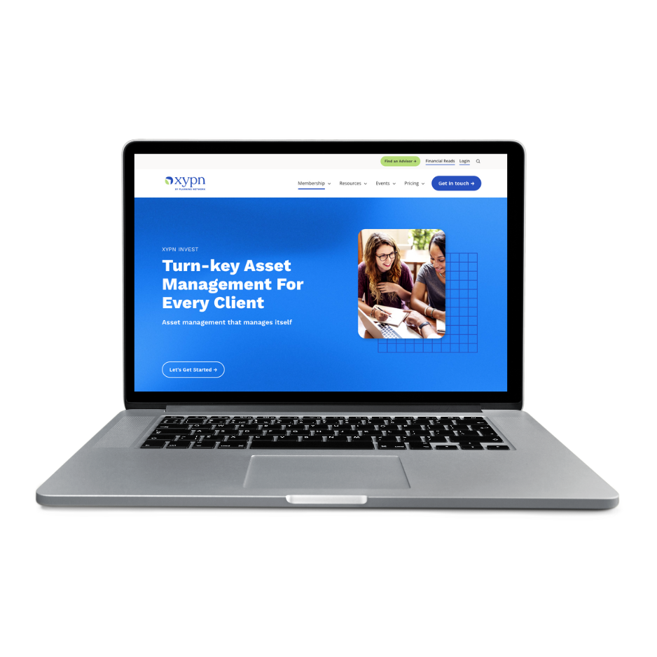
MUTUAL FUNDS ONLY
MIN: $100
Fact Sheets & Performance
Kick Start
Kick start is ideal for small balances because it provides broad geographical coverage in a simple, 3-fund model. This model is implemented with mutual funds to allow for purchases less than the typical cost of single ETF shares in these asset classes.
 |  | Standard Model
Asset Class | Fund | Ticker |  | Target |  |  | .
Large Blend | Schwab Total Market Index | SWTSX |  | 60.0%
Foreign Large Blend | Schwab International Index | SWISX |  | 40.0%
Intermediate Bond | Schwab US Aggregate Bond Index | SWAGX |  | 100.0%

Slide 7
ETFs ONLY
MIN: $10,000
Fact Sheets & Performance
Cause
Cause is a great option for those who want to incorporate ESG—environmental, social, and corporate governance factors—into their investment strategies.
 |  | Standard Model |  |  |  | Tax-Sensitive Model
Asset Class | Fund | Ticker | Alt. | Target |  | Ticker | Alt. | Target
Large Growth | Nuveen ESG Large Cap Growth | NULG | VOOG | 18.0% |  | NULG | VOOG | 18.0%
Large Value | Nuveen ESG Large Cap Value | NULV | VOOV | 18.0% |  | NULV | VOOV | 18.0%
Small Blend | Nuveen ESG Small Cap | NUSC | IJR | 24.0% |  | NUSC | IJR | 24.0%
Foreign Large Blend | iShares ESG Advanced MSCI EAFE ETF | DMXF | ESGD | 24.0% |  | DMXF | ESGD | 24.0%
Emerging Markets | iShares ESG Aware MSCI EM ETF | ESGE | VWO | 11.0% |  | ESGE | VWO | 11.0%
Real Estate | iShares Global REIT | DFGR | REET | 5.0% |  | DFGR | REET | 5.0%
Corporate Bond | Vanguard ESG US Corporate Bond ETF | VCEB | SUSC | 30.0% |  | MUNI | MUB | 90.0%
Intermediate Government | SPDR Intermediate Term Treasury ETF | SPTI | VGIT | 20.0%
World Bond - USD Hedged | iShares Global Green Bond ETF | BGRN |  | 30.0%
Short Term Bond | iShares ESG 1-5 Year USD Corp Bond ETF | SUSB |  | 10.0%
Inflation Protection | Vanguard ST Inflation Protection | VTIP | STIP | 10.0% |  | VTIP | STIP | 10.0%

Slide 8
ETFs ONLY
MIN: $10,000
Fact Sheets & Performance
BRI
This model is comprised of primarily Biblically Responsible Investments and is best suited for those looking to align their investments with faith-based values.
 |  | Standard Model |  |  |  | Tax-Sensitive Model
Asset Class | Fund | Ticker |  | Target |  | Ticker |  | Target
Large Blend | Inspire 500 ETF | PTL |  | 36.0% |  | PTL |  | 36.0%
Small Cap | Timothy Plan Small Cap Core | TPSC |  | 24.0% |  | TPSC |  | 24.0%
Foreign Large Blend | Timothy Plan International | TPIF |  | 40.0% |  | TPIF |  | 40.0%
Corporate Bond | Vanguard Intermediate Corp | VCIT | SPAB | 30.0% |  | MUNI | MUB | 90.0%
Intermediate Government | SPDR Intermediate Treasury | SPTI | VGIT | 20.0%
World Bond - USD Hedged | Vanguard Total International Bond | BNDX | IAGG | 30.0%
Short Term Bond | Vanguard ST Corporate Bond | VCSH | IGSB | 10.0%
Inflation Protection | Vanguard ST Inflation Protection | VTIP | STIP | 10.0% |  | VTIP | STIP | 10.0%

Slide 9
Questions?

Slide 10
Disclosures
This information is not intended to be used as the primary basis for investment decisions, nor should it be construed as advice designed to meet the particular needs of an individual investor. Investing in mutual funds, ETFs, and other equity and debt securities involves risk, including loss of principal. An investor should consider a portfolio’s investment objectives, risks, and expenses carefully before investing. Please read any applicable funds’ prospectus carefully before investing. Investors cannot invest directly in an index. Indexes are unmanaged and reflect reinvested dividends and/or distributions, but do not reflect sales charges, commissions, expenses or taxes.
XYPN Invest constructs and manages investment models (“Model Portfolios”) through a technology solution. The Model Portfolios can be used by investment adviser representatives (“IARs”) of XYPN Invest, an SEC registered investment adviser (“RIA”), as well as IARs of other unaffiliated RIAs (“iIARs”). iIARs are members of XYPN, but not affiliated with the XYPN Invest RIA. XYPN Invest manages its Model Portfolios on a discretionary basis primarily by allocating assets among various mutual funds and exchange-traded funds (“ETFs”). XYPN Invest may allocate to individual securities in certain circumstances. IARs and iIARs are ultimately responsible for choosing the appropriate Model and overall allocations for their Clients.

