Slide 1


Monthly Office Hours
July 10, 2024

Slide 2
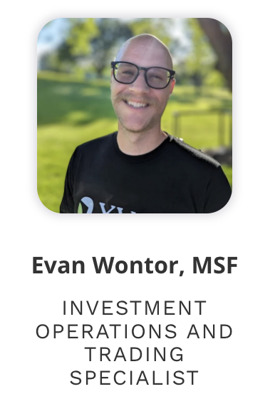

Our team keeps growing!
Client Service Manager
Starting in July!

Slide 3
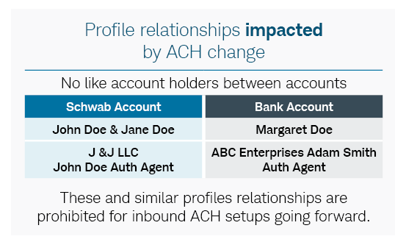
Schwab Updates
New Rules for Inbound ACH

Slide 4

Schwab Updates
Processing times are speeding up! Some account types are opening in less than 24 hours!

Slide 5

Schwab Updates
Tax Withholding for Retirement Distributions (For most states)

Slide 6
Reminder!
TD Ameritrade/VEO Drawdown
All transactions into/from TD Ameritrade Institutional accounts will be rejected beginning on July 12, 2024.
VEO One will not be available to advisors or Schwab employees as of July 22, 2024

Slide 7

Reminder!
New Phone System (Zoom Phone)
We changed our phone system! When you call in you will hear our main menu. Press 3 for TAMP Support!
*We no longer have a live receptionist, so you may be directed to our voicemail when the team is unavailable. We’ll call back as soon as we’re able!

Slide 8


Important Dates
1
Quarterly Market Review
Tuesday, July 16th | Register Here!
Jeff Snodgrass: 5-Year Sabbatical
July 15 - August 9, 2024
2
Reminder: The best way to contact us via email is to use our team inbox:
support@xyinvestmentsolutions.com

Slide 9

June Growth Award Winner
Cynthia Meyer, owner of Real Life Planning, is a back-to-back winner for both May and June. Cynthia had the highest net new assets, month over month. Congrats, Cynthia!

Slide 10

Questions?

Slide 11
Disclosures
This information is not intended to be used as the primary basis for investment decisions, nor should it be construed as advice designed to meet the particular needs of an individual investor. Investing in mutual funds, ETFs, and other equity and debt securities involves risk, including loss of principal. An investor should consider a portfolio’s investment objectives, risks, and expenses carefully before investing. Please read any applicable funds’ prospectus carefully before investing. Investors cannot invest directly in an index. Indexes are unmanaged and reflect reinvested dividends and/or distributions, but do not reflect sales charges, commissions, expenses or taxes.
XYPN Invest constructs and manages investment models (“Model Portfolios”) through a technology solution. The Model Portfolios can be used by independent registered investment advisers (“RIAs”) that are members of XYPN, but not affiliated with the XYPN Invest. XYPN Invest manages its Model Portfolios on a discretionary basis primarily by allocating assets among various mutual funds and exchange-traded funds (“ETFs”). XYPN Invest may also allocate assets in individual debt and equity securities. While XYPN Invest will select mutual funds and ETFs for the Model Portfolios, provide guidance and information about the Model Portfolios to RIAs, RIAs are responsible for choosing the specific model and allocation for each of their Clients.

