Slide 1




2025 Q2
Quarterly Market Review
Presented By: Mario Nardone, CFA

Slide 2
Glass half-full
Glass half-empty
Short-to-intermediate bonds performed well in Q2
U.S. stocks rebounded in Q2
Recent macroeconomic data suggests the labor market continues to remain solid
Inflation declined to 2.4% in the last reading from May 2025 relative to the 2.9% seen in December 2024
Continued uncertainty around tariffs and ongoing trade wars between U.S. and international trade partners
U.S. federal government debt rating was downgraded in May
Continued geopolitical concerns in the Middle East and between Russia/Ukraine
Full effect of tariffs on inflation might not be fully realized yet
Notes:
As always, we like to take a balanced approach to looking at the global economy and markets, not reacting too positively or negatively to any particular news item. Because it’s important to have a broad perspective and maybe even a sense of cautious optimism with what the future might hold.
From a glass-half-full perspective, both stocks and bonds were up during the quarter around the world. In the U.S., stocks were able to recover to post strong gains during Q2 even after they stumbled out of the gate in April. From a macroeconomic perspective, inflation continues to moderate and the labor market remains resilient.
From a glass-half-empty perspective, there is always trouble on the horizon. We have numerous sources of uncertainty to deal with in ongoing trade wars, a tenuous tariff outlook, another U.S. government debt downgrade, and a continuation of geopolitical concerns in the ongoing war between Russia and Ukraine and now the Middle East.
Now, let’s take a look at Q2 by the numbers to put some quantitative context to what we see here.

Slide 3
Q2 2025 by the numbers
90 + 23 represents the original 90-day extension granted by President Trump stemming back to early April where he lowered the “Liberation Day” reciprocal tariff rates to 10% while allowing trade partners more time to negotiate. He has recently extended that deadline another 23 days to August 1.
9 is the number of all-time highs for the S&P 500 index posted in the first half of 2025. This includes a single daily increase of 9.5% on April 9, the day of the tariff-pause announcement, which is the best daily performance for the index since 2008.
-5.6% is the median S&P 500 Index drawdown in reaction to geopolitical shocks throughout history.
+7.2% is the YTD return of a portfolio comprised of 60% MSCI ACWI and 40% Bloomberg Global Aggregate (hedged USD). In other words, despite the unnerving headlines so far this year, a globally balanced portfolio comprised of both stocks and bonds is now outperforming the S&P 500 by 1% YTD.
Notes:
To put numbers to the market’s ongoing narrative, here we highlight a few relevant data points in an attempt to give clarity to what’s been transpiring over the last quarter.
First, President Trump’s original 90-day pause on the sweeping “Liberation Day” reciprocal tariffs have been extended an additional 23 days from July 9 to August 1 to allow U.S. trading partners additional time to negotiate. This brings the possibility for potentially lower tariff rates going forward if all sides can come to an agreement.
9 is the number of all-time highs set by the S&P 500 index in the first half of the year, including the largest single-day increase since 2008 of 9.5%, which was set on the day that the tariff-pause was announced.
-5.6% is the median drawdown for the S&P 500 index in response to geopolitical shocks like we’ve seen unfolding in the Middle East. Later in the presentation, we’ll put this number into more context.
Last, given all that’s happened so far this year let alone last quarter, a globally diversified portfolio is actually up 7.2% so far this year and is beating the S&P 500 by 1% YTD, which reminds us all to not overreact to the latest headlines and that diversification is a necessary tool for long-term success.
Now, let’s dive a little deeper into some of the theme’s from Q2.

Slide 4
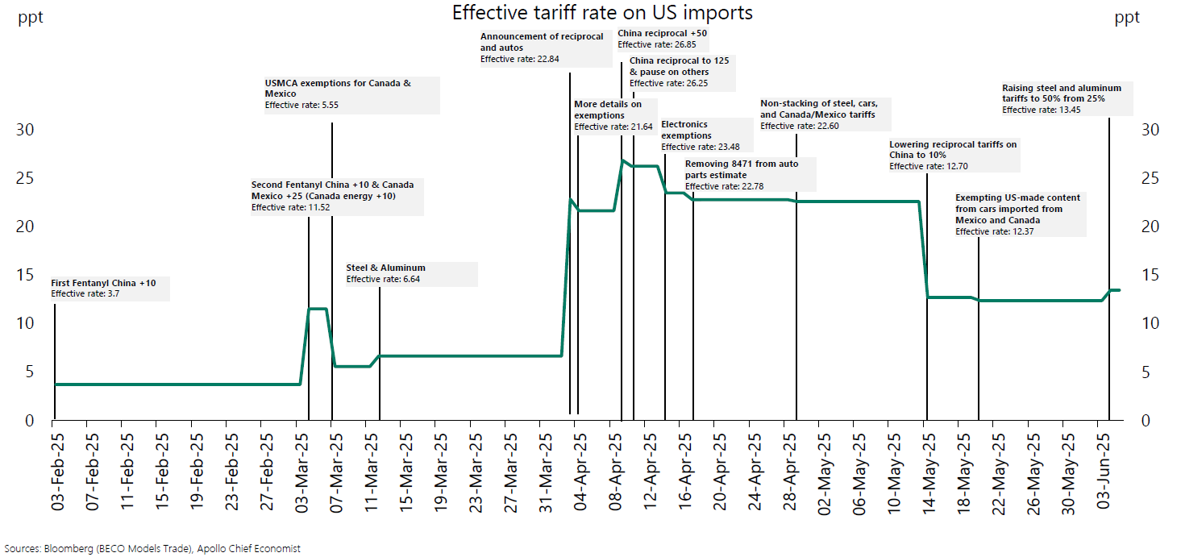
The tariff timeline
Notes:
Like the first quarter of the year, Q2 headlines continued to be dominated by trade wars and White House tariff policies. And again, like last quarter, the Trump administration’s tariff policies continued to be fluid along with the response from international trading partners.
This chart shows a timeline of major tariff policies dating back to early February of this year along with the estimated effective tariff rate on U.S. imports of various goods. As of February 3, we started with an effective tariff rate of just under 4%. On Liberation Day in early April to begin Q2, this rate jumped to 23% before hitting a YTD high of just under 27% weeks later. This caused significant drawdowns in U.S. stock markets given how higher tariffs made doing business in the U.S. more uncertain and likely more costly to corporations and consumers. In the following months, the U.S. and various trading partners held trade negotiations, although little detail has been shared on deal specifics so far. However, this resulted in progress as the effective tariff rate finished the quarter at 13.5% during which markets began to rebound.
While no one can predict the future with precision, it seems likely that tariffs in some form or level will stay for the foreseeable future. And U.S. businesses and consumers will have to adapt.

Slide 5
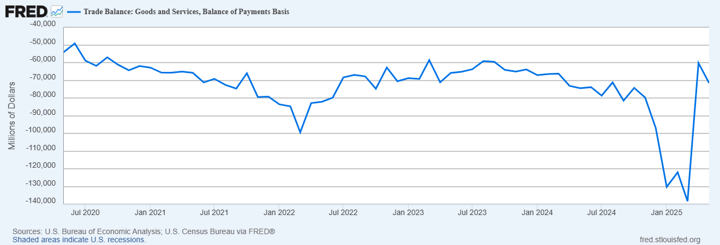
Tariff’s Effect on U.S. Trade Balance
Notes:
Going forward, U.S. businesses and consumers will be faced with a choice. Either pay more for the products and materials you are used to buying abroad or beginning purchasing domestically.
Here we see how these decisions have played out over the last few years. This chart shows the U.S. trade balance which is the difference between the amount of goods and services imported from abroad and those exported internationally. The more negative the figure here, the more the U.S. is importing versus exporting.
Over the last five years, the U.S. has been a net importer on a monthly basis by around 60-80 billion dollars a month. Beginning in the middle-to-end of 2024, we see that negative balance begin to grow sharply and almost double as businesses and consumers increasingly expected then president-elect Trump to employ tariff-like tactics soon after being sworn into office. And shortly after the year began, that trade balance begins to shrink quickly. This means that businesses and consumers likely stockpiled cheaper goods from abroad ahead of any trade barriers being enacted. Once these stockpiles run low, businesses will have to decide where to go next.

Slide 6
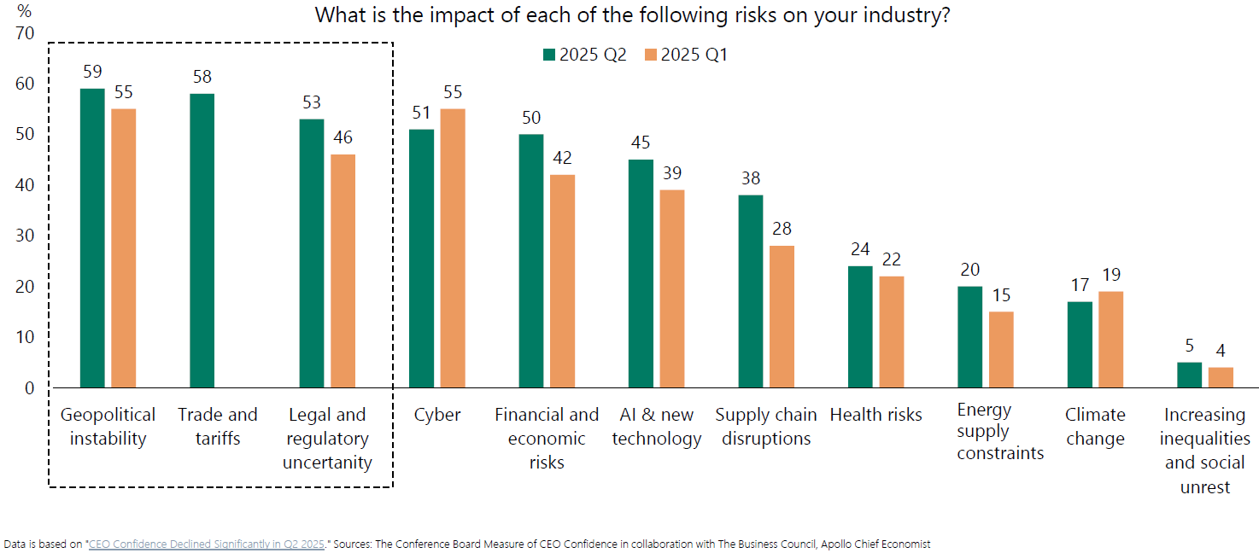
Tariff’s Effect on U.S. Business Risk
Notes:
This slide further emphasizes how quickly tariff shocks materialized in U.S. companies. A survey from the Conference Board Measure of CEO Confidence asked business leaders what they were most concerned about on a quarterly basis. The results for Q2 indicate that trade and tariffs, something that was not even on their radar in Q1, is now extremely concerning to CEOs.

Slide 7
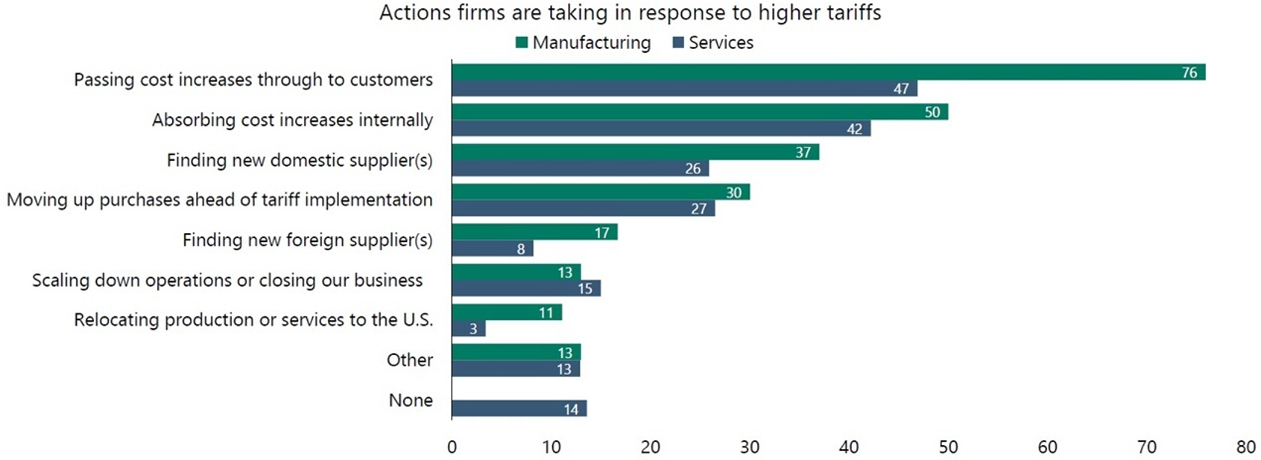
Tariff’s effect on U.S. businesses & consumers
Sources: Federal Reserve Bank of Dallas, Apollo Chief Economist
Notes:
Here, we show how U.S. businesses are planning to deal with higher tariffs and how those decisions could affect consumers. Between manufacturing and service providers, a number of firms plan to absorb at least a portion of cost increases, find a new supplier, move up purchases ahead of tariff implementations, or even extreme measures like scaling down or closing operations. However, particularly in the manufacturing segment, companies plan to pass along cost increases to consumers. Ultimately, firms are likely to implement a combination of cost absorbing and cost pass-thru measures. This combination could both lower corporate profitability, increase product prices, and leave consumers with less purchasing power over time. This scenario could detract from future market performance and spur inflation.

Slide 8
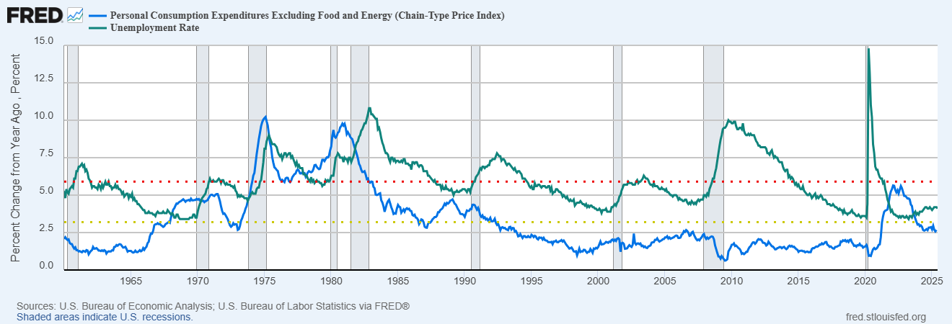
Fed’s wait-and-see approach
Notes:
Tariff uncertainty, in addition to making things difficult for businesses and consumers, can also complicate things for the Fed. So far, it’s unlikely that we’ve seen the full effect of tariffs flow through to prices and inflation, of which the latest reading for headline inflation was 2.4% in May. So far, we’ve seen both broad inflation measures and the Fed’s preferred inflation gauge, the Core Personal Consumption Expenditures Index (or Core PCE) continue to hover below 3% on a year-over-year basis as measured by the blue line on this chart. The unemployment rate, measured by the green line, also sits at 4.1% and near all-time lows. Given that both components of the Fed’s dual mandate of maintaining low unemployment and stable prices are near or below their trailing 60-year averages of 5.9% (measured by the red dotted line) and 3.2% (measured by the yellow dotted line) respectively , it’s unlikely that the Fed will begin to cut rates quickly even if markets expect rate cuts to resume by year’s end. For now, it’s a wait-and-see approach.

Slide 9
Global bond returns
Source: Morningstar, Bloomberg and ICE BofA ML benchmarks shown. Past performance is not indicative of future results.
Notes:
Now let’s take a look at how different segments of the global bond market fared in Q2.
US and global bond returns were all positive for the second quarter.
Over the last three months, Treas/Corp returns have outpaced munis as yields dropped over short-to-intermediate portions of the U.S. Treasury curve with credit spreads remaining relatively tight.
All bond returns shown are positive over the last 12 months with IT Corps earning the most at 8.6%,owed to declines in IT term yields and credit spreads as we’ll see on the next page.

Slide 10
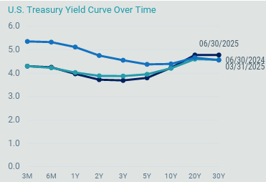
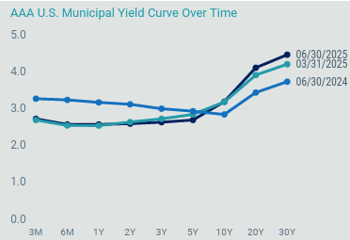
Yield curve changes
Source: Avantis Investors, Bloomberg, data as of 6/30/2025
Notes:
On this slide, If we focus on the chart on the left first, we will see that compared to last quarter end, short term rates (which the Fed controls) stayed the same over the quarter while longer term yields rose slightly. You can also see that there is still some inversion on the shorter and intermediate parts of the curve end but not on the longer ends. Short-to-intermediate term yields dropped over the 12-months ending June 30, hence the positive short-to-intermediate term bond returns on the previous page.
The chart on the right is the muni curve. Importantly, you can see it is shaped differently from the Treasury curve. Different factors drive each market, so it highlights how each type of bonds can move differently at various times for different reasons. The muni curve shows that longer term yields rose over the quarter but intermediate term yields fell slightly in some cases.

Slide 11
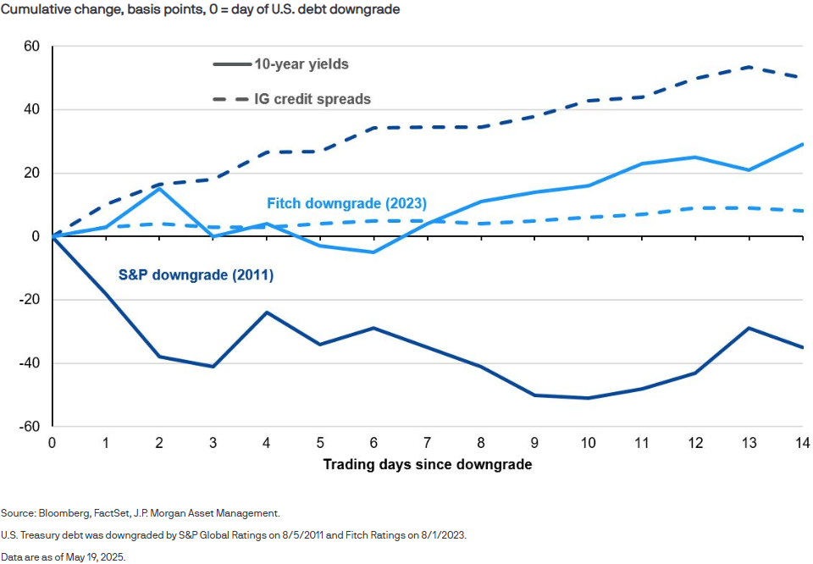
Market Reaction to U.S. Credit Downgrades
Notes:
In mid-May, Moody’s followed the S&P and Fitch’s prior decisions (in 2011 and 2023 respectively) to strip the U.S. federal government of its last AAA credit rating. Depending on the credit rating agency, there are only two corporations who hold a higher credit rating than the U.S.: Johnson & Johnson and Microsoft. However, like prior credit rating downgrades, this does not necessarily spell doom and gloom for U.S. federal debt. This is not new news. Like prior downgrades, Moody’s cited the increase in government debt and rise in interest costs as cause for the downgrade, according to JPM. Yet another credit downgrade highlights a potential longer-term concern for the U.S. government debt market, and it’s need to reign in continued deficit spending.
This chart looks at prior downgrades and the 14 trading days that followed. In 2011 as pictured by the dark blue lines, we saw 10-year yields drop and investment grade credit spreads widen while in 2023 as pictured in the light blue lines, both measures increased during the following 2.5 weeks. This time around in May, we saw 10-year treasury yields briefly jump as much as 0.15% by the third trading day post-downgrade even though 10-year treasury yields finished the quarter 0.19% LOWER than where they were on the day of the downgrade with credit spreads also remaining relatively tight.
For now, the U.S. dollar and federal government bonds remained heavily intertwined in the global trade ecosystem. This does also provide a potential opportunity for increased bond diversification by allocating to bonds outside of the U.S.

Slide 12
US stock returns by size and style
Source: Morningstar, Russell benchmarks shown. Past performance is not indicative of future results.
Notes:
Now, let’s take a look at the quarter’s performance for U.S. stocks
US stocks were positive for Q2, despite the rocky start to the quarter in April. Uncertainty around tariffs and trade wars weighed on small cap stocks across the valuation spectrum on a YTD basis.
Over the last 12 months, all stock segments are positive with small-cap and value stocks lagging the market.

Slide 13
Mag 7 support dwindled
Company/Index | Microsoft | NVIDIA | Meta | U.S. Stock Market | Amazon | Alphabet | Tesla Inc | Apple Inc
Growth of a Dollar | $ 1.22 | $ 1.13 | $ 1.03 | $ 1.01 | $ 0.97 | $ 0.96 | $ 0.90 | $ 0.84
Source: WSJ.com, Morningstar. U.S. Stock Market represented by Russell 3000 Index. Past performance is not indicative of future results. Performance calculated from 2/19/25 to 6/30/25 to reflect performance from prior YTD market high.
Notes:
Like we’ve said before, this year let alone this quarter have been a wild ride for stock investors in the U.S. On the prior slide, we saw large-cap growth stocks lead the market this quarter, however that might not tell the whole story.
Extending the starting point back to February 19 of this year, the prior YTD high for the U.S. market, we can put the stellar Q2 performance in better context. Here we show the individual stock performance of the collective Magnificent 7 companies in the dark grey lines and plot the U.S. stock market performance over the same period in the red line. During this time, only two of the seven stocks beat the U.S. market by more than 2%. Four of the seven stocks ended the period in negative territory, with Apple lagging the furthest behind with a 16% decline. Early on in the period, Tesla stock was down as much as 37%. This highlights the fragility in a U.S.-only, or concentrated single-stock strategy.

Slide 14
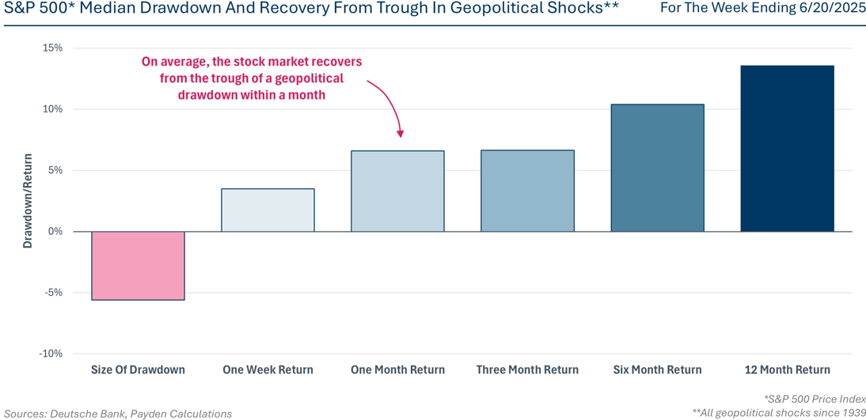
Market reactions to geopolitical shocks
Notes:
We continued to see tensions in the Middle East as Israel and Iran began exchanging blows as well as ongoing conflict between Russian and Ukraine. In both conflicts, oil prices reacted with dramatic swings up and down because of the uncertainty around how the energy infrastructure would fare. It also emphasizes the idea that geopolitical shocks are nothing new to markets. This chart shows that the median size of a drawdown in the S&P 500 responding to such shocks dating back to 1939 is only -5.6% as shown in the red bar to the far left. Moreover, data shows that on average, markets take an average of only 1 month to recover losses and go on to return an average of 14% over the next 12-month period following the shock. This goes to show that a long-term mindset is expected to serve investors well.

Slide 15
International developed and emerging market stock returns
Source: Morningstar, MSCI benchmark shown. Past performance is not indicative of future results.
Notes:
Non-US stocks were all positive for the quarter, YTD, and trailing 12-month periods in developed and emerging markets.
Intl. large cap value stocks gained the most so far this year at 21.9% YTD while intl. small-cap growth stocks gained the most this quarter at 19%.
Interestingly, during the last 12 months, international developed large cap stocks have outpaced their U.S. counterparts by 3%, while international small cap developed stocks have outpaced their U.S. counterparts by an even larger 15%.
The returns of non-US stocks over the recent months highlight the value of diversification.

Slide 16
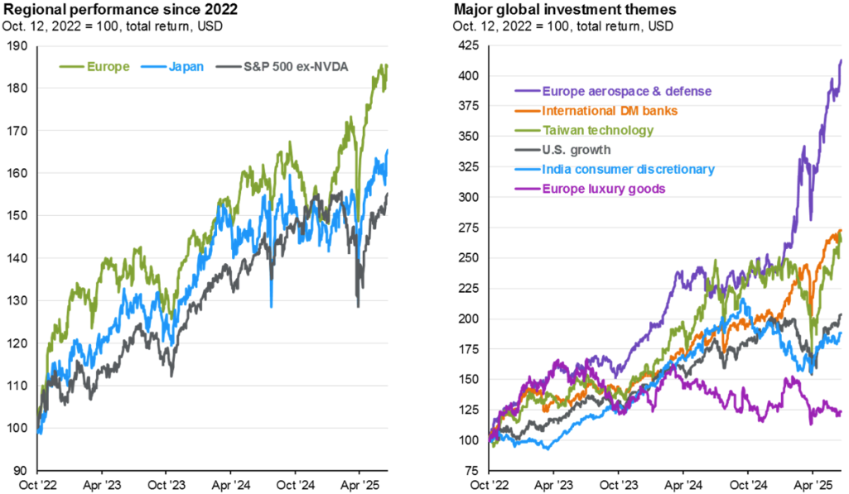
Regional ex-U.S. performance is robust
Source: FactSet, MSCI, J.P. Morgan Asset Management. 10/12/2022 was the market bottom for U.S. equities. (Right) Russell. Each country/sector/industry is represented by its respective MSCI index except U.S. growth, which is represented by the Russell 1000 Growth Index.
Notes:
The charts display international stock performance by region and sector relative to different measures of U.S. stock performance since the beginning of the current bull market for U.S. stocks beginning in October 2022 through the second quarter of this year. Looking at the chart on the left, we can see that both European and Japanese stocks have outperformed U.S. stocks when removing Nvidia. Similarly in the chart on the right, we look at different regional sector performance versus U.S. large growth stocks and see that different stock sectors outside of the U.S. have been growing rapidly, namely European aerospace and defense companies.
And while our crystal ball is always cloudy, there is still reason to believe that an international equity allocation is an additive component of a well diversified portfolio.

Slide 17
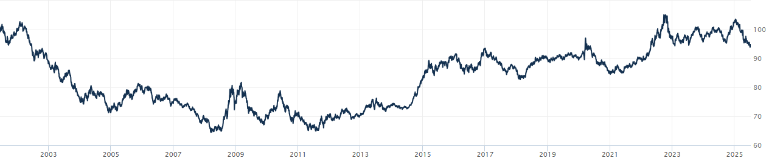
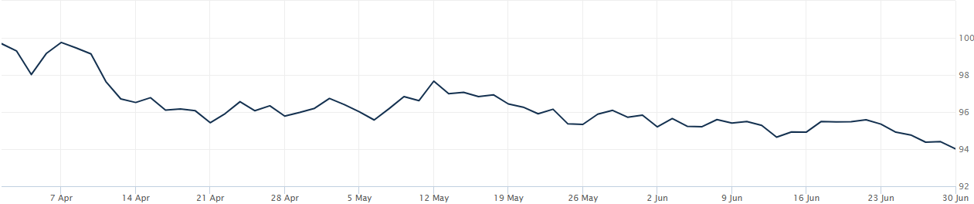
Dollar strength is good for US consumers but bad for owners of non-US investments
Source: Wall Street Journal as June 30, 2025. Past performance is not indicative of future results.
Notes:
WSJ’s Dollar Index (BUXX) represents the value of the USD relative to a basket of 16 foreign currencies.
A rising dollar is generally good for US consumers as it makes foreign goods cheaper to purchase, but bad for owners of non-dollar-denominated assets, such as foreign stocks. Said differently, a strong dollar hurts international returns. A strong dollar also hurts US exports and therefore can also negatively impact US production and employment.
The top chart shows the movement over the last 20+ years for longer term trends while the bottom chart shows the last 3 months where the dollar declined. The top chart shows the dollar is currently still stronger than most other time since the inception of this WSJ Dollar Index. A US Dollar decline would be a tailwind for non-US equity returns vs. US equities, the opposite is also true. The bottom chart shows the USD weakened over Q2 2025. The dollar decline has been at least a part of the reason for recent strong returns in international equities.

Slide 18
Maintain your focus on what really matters
Financial planning is a process, not an endpoint
Concentrate on long-term goals and objectives
Focus on reaching goals, not on beating benchmarks
Maintain a disciplined approach, in good and bad markets
Invest broadly and globally; asset allocation is key
Reduce investment and tax costs where possible
Rebalance as necessary
Notes:
Do investments matter? Of course they do; however it is not investments alone that will help you achieve your goals. Maintaining a focus on these bullet points is what really matters in helping you achieve your goals.

Slide 19
Disclosures
This information is not intended to be used as the primary basis for investment decisions, nor should it be construed as advice designed to meet the particular needs of an individual investor. Investing in mutual funds, ETFs, and other equity and debt securities involves risk, including loss of principal. An investor should consider a portfolio’s investment objectives, risks, and expenses carefully before investing. Please read any applicable funds’ prospectus carefully before investing. Investors cannot invest directly in an index. Indexes are unmanaged and reflect reinvested dividends and/or distributions, but do not reflect sales charges, commissions, expenses or taxes.
XYPN Invest constructs and manages investment models (“Model Portfolios”) through a technology solution. The Model Portfolios can be used by investment adviser representatives (“IARs”) of XYPN Invest, an SEC registered investment adviser (“RIA”), as well as IARs of other unaffiliated RIAs (“iIARs”). iIARs are members of XYPN, but not affiliated with the XYPN Invest RIA. XYPN Invest manages its Model Portfolios on a discretionary basis primarily by allocating assets among various mutual funds and exchange-traded funds (“ETFs”). XYPN Invest may allocate to individual securities in certain circumstances. IARs and iIARs are ultimately responsible for choosing the appropriate Model and overall allocations for their Clients.

